Slide 1


Institute of Cognitive Integrated Sensor Systems Department of Electrical and Computer Engineering
Advanced Calibration Techniques for TMR Sensor Angle Measurement
Master Thesis, 8 Nov 2024
Yue Hu
Supervisor: Msc. Elena Gerken, Prof. Dr.-Ing. Andreas König

Slide 2
Overview
1. Introduction and Background
2. Theoretical Background
3. Methodologies:
Linear calibration
Harmonic Calibration
Ellipse Fitting for Calibration
CNN for Calibration
4. Results
5. Conclusion

Slide 3
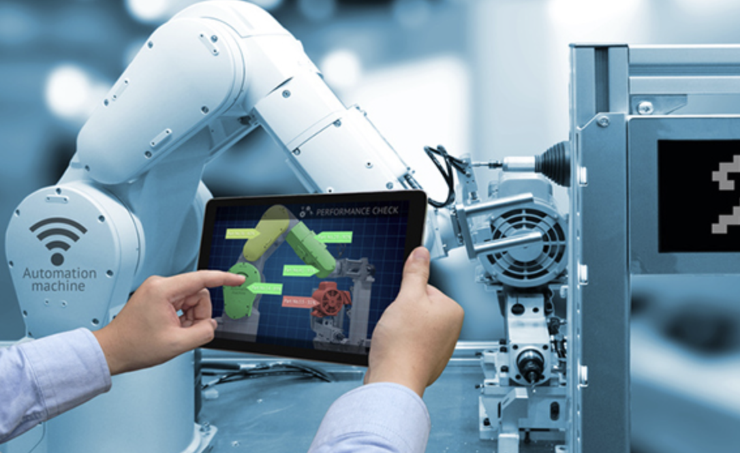
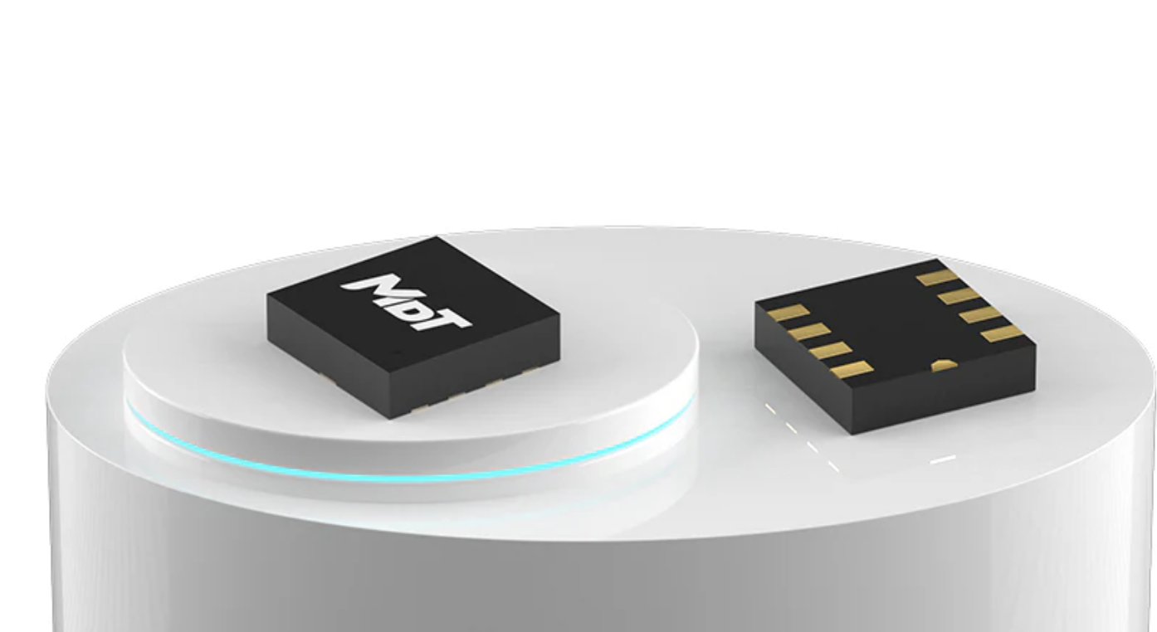
Introduction and Background
https://www.sensitec.com/about-sensitec/news-events/news/news-details/news/ta903-tmr-freepitch-sensor-for-angle-measurement
https://tmr-sensors.com/zh/products/tmr3005-dual-axis-tmr-angle-sensor

Slide 4
Introduction and Background
In recent years, the use of XMR sensors, particularly TMR sensors, has rapidly expanded across fields requiring precise angular measurements, including robotics and automotive applications.
TMR sensors, based on the tunneling magnetoresistance effect, offer high-resolution measurements with low power consumption, distinguishing them as the latest advancement in magnetic sensor technology.
However, challenges remain due to measurement errors arising from sensor imperfections, environmental influences, and signal processing issues.
To address these limitations, this study focuses on improving TMR sensor calibration, aiming to enhance measurement accuracy and reliability in applications where precision is crucial.

Slide 5
Theoretical Background
1. Linear Calibration Methods：
For applications that require experimental data processing, output signals from the TMR measurement system are often refined through data processing techniques such as linear regression fitting or the use of calibration tables. And some other useful calibration techniques such as back-end calibration approach effectively reduces measurement errors and enhances the accuracy of the system.[8]-[11]
2. Harmonic Analysis：
Calibration models derived from harmonic analysis can account for eccentricity, friction, and transmission errors, with some approaches yielding up to a 90% reduction in inaccuracies. Despite these successes, harmonic analysis may lack flexibility in adapting to changes in real-time operational conditions and it often hard to implement.[12][13]

Slide 6
Theoretical Background
3. Ellipse Fitting Techniques：
Some studies propose ellipse fitting models to enhance angular accuracy. By incorporating geometric properties and optimizing least-squares techniques, these approaches improve computational efficiency and robustness, even in noisy data environments. Nonetheless, traditional ellipse fitting methods are sometimes constrained by noise interference and convergence inefficiencies (parameter prediction and hard to find the correct parameter solution), impacting the stability and reliability of measurements.[15]-[20]
4. CNN-Based Calibration：
Neural networks, as explored in the previous research, present innovative ways to address sensor errors, particularly under dynamic environmental conditions. CNN-based calibration has reduced angular errors significantly, yet it often requires extensive training data and is prone to greater complexity and requires more computational resources. Therefore, selecting an optimal structure and parameters must be carefully tailored to the specific application to balance accuracy with computational efficiency.[21]-[24]

Slide 7
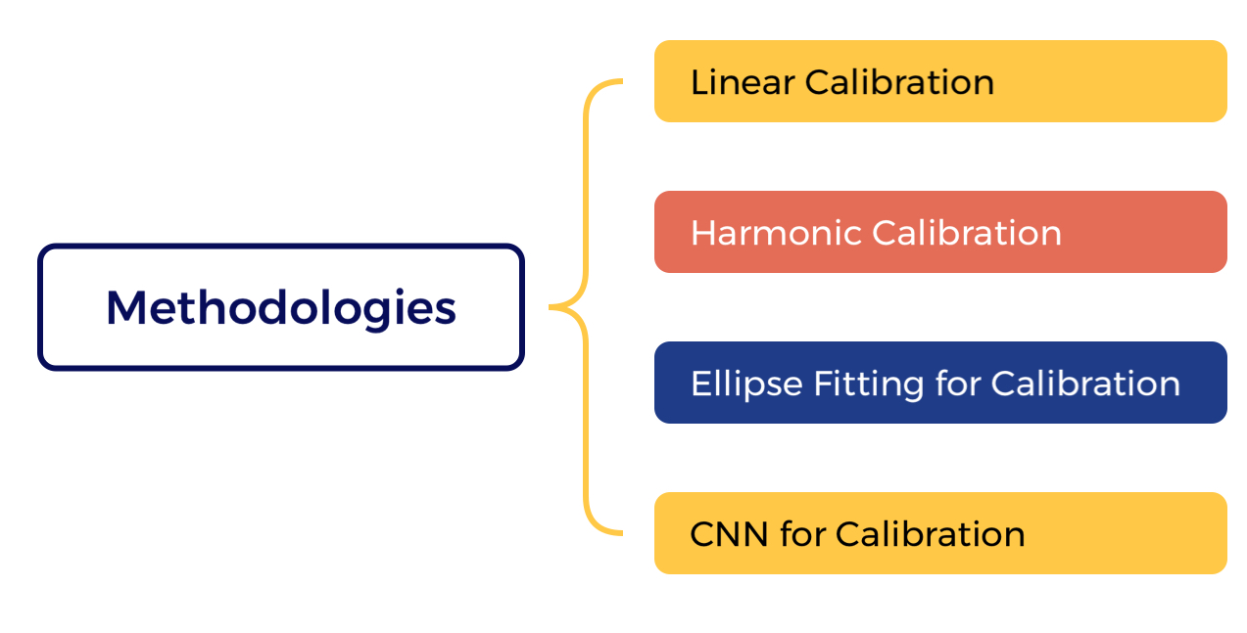
Methodologies

Slide 8
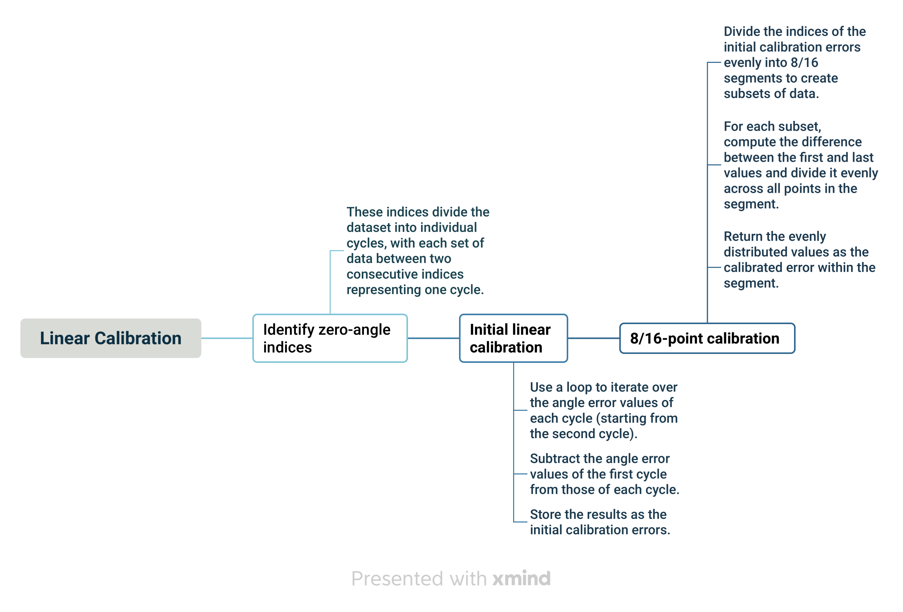
Linear Calibration
[8]

Slide 9
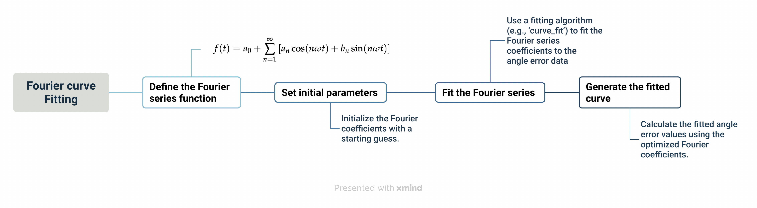
Harmonic Calibration
[13][41]

Slide 10
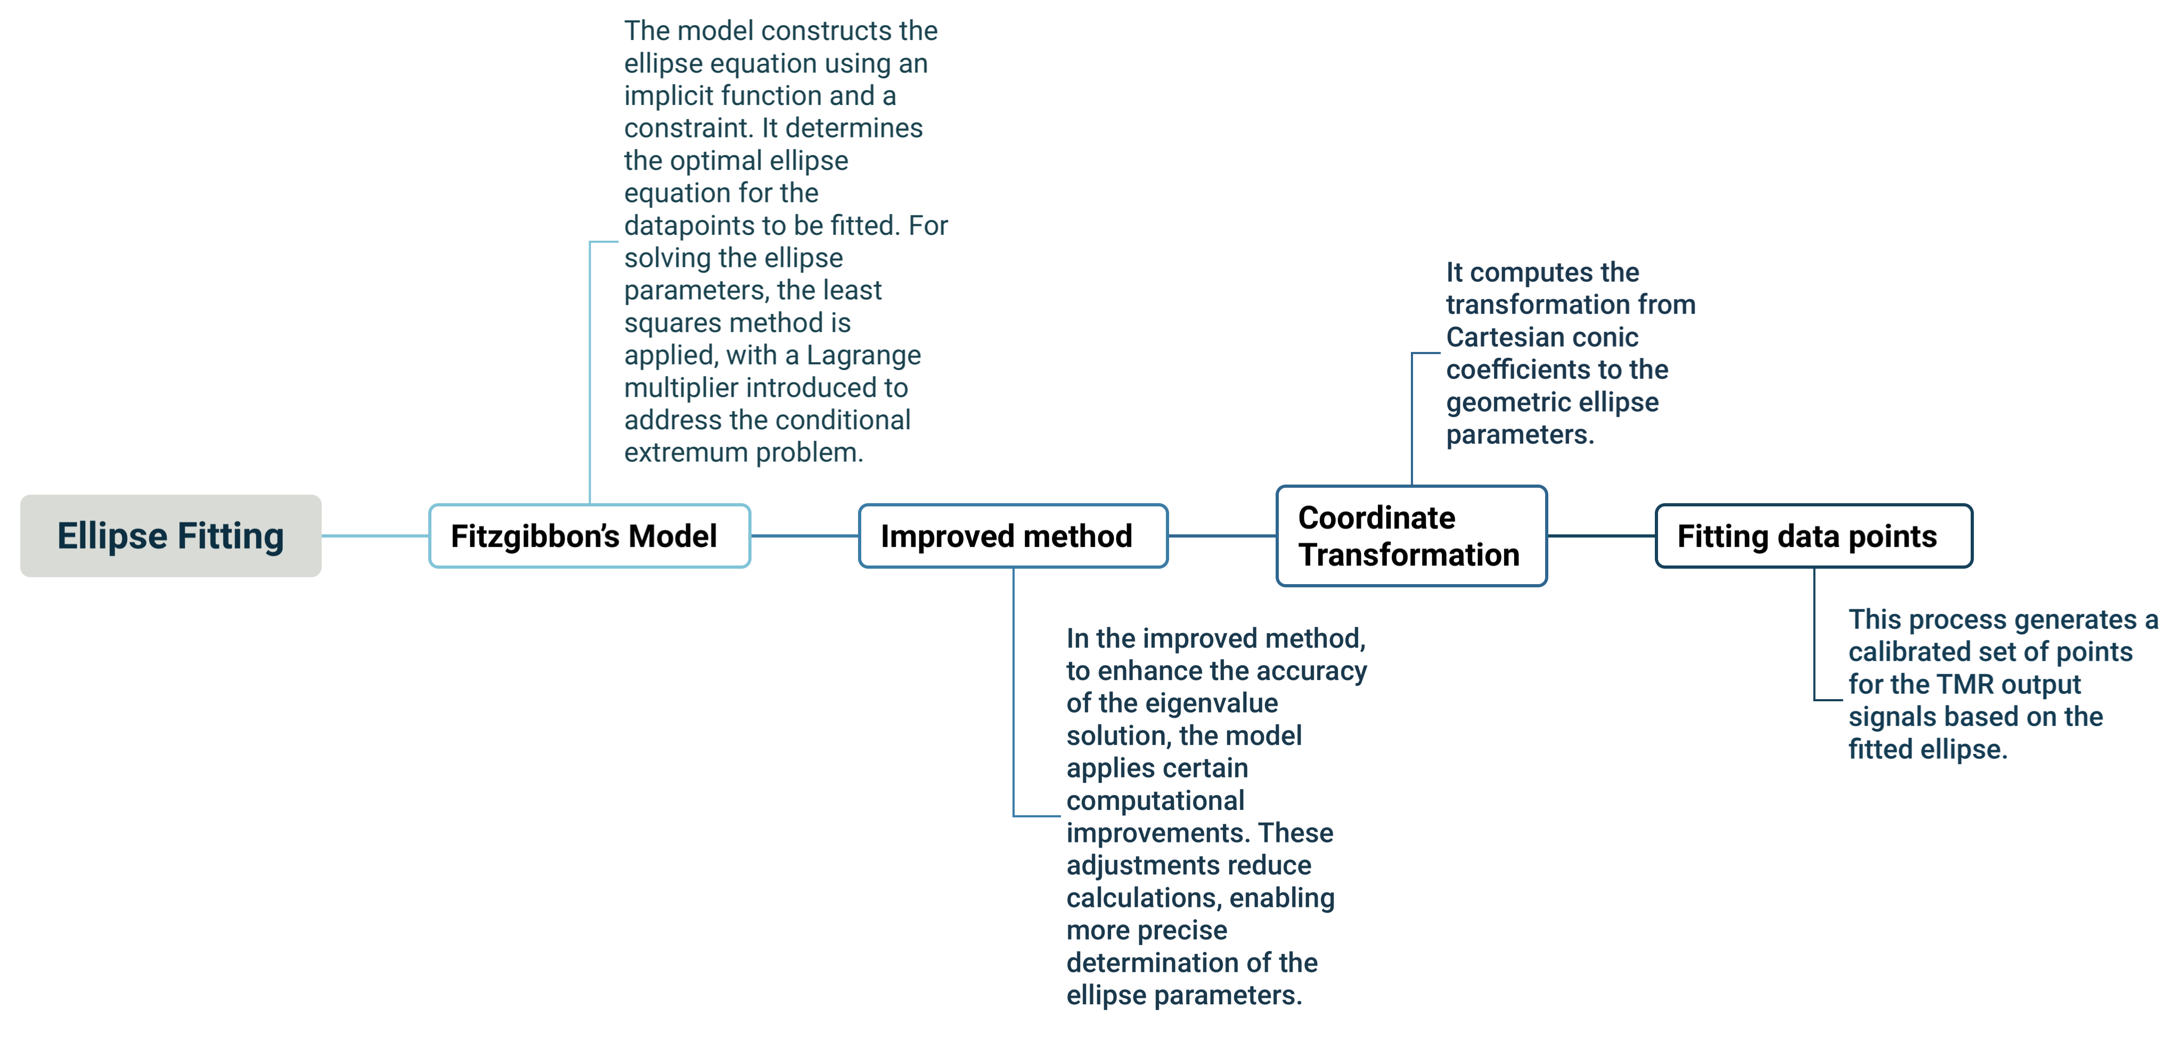
Ellipse Fitting
[16][43]

Slide 11
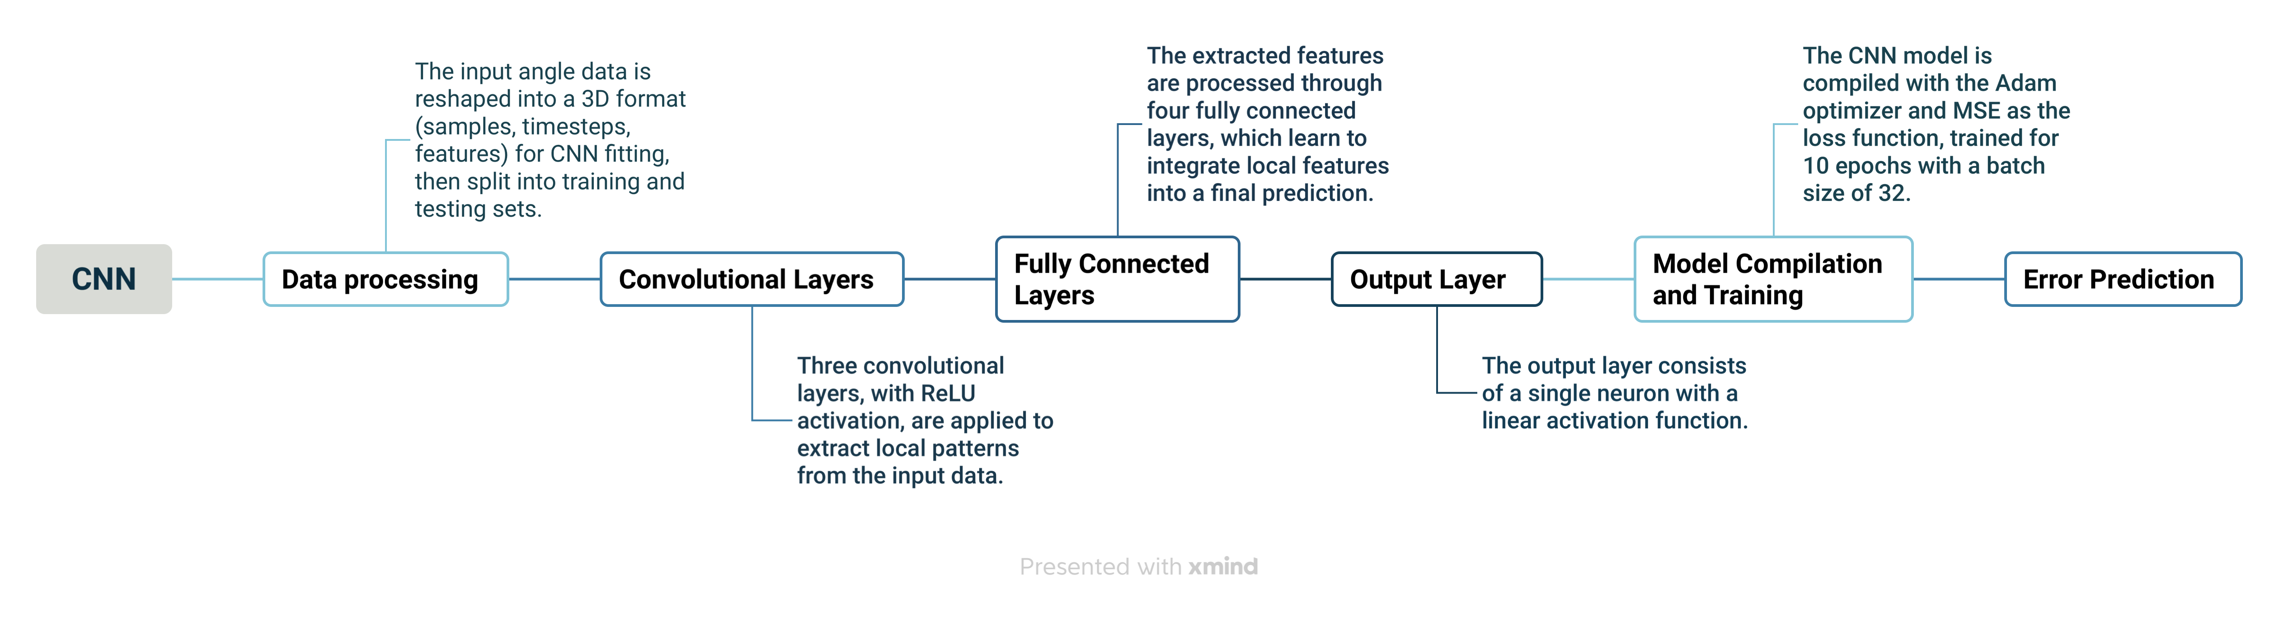
CNN
[21]

Slide 12
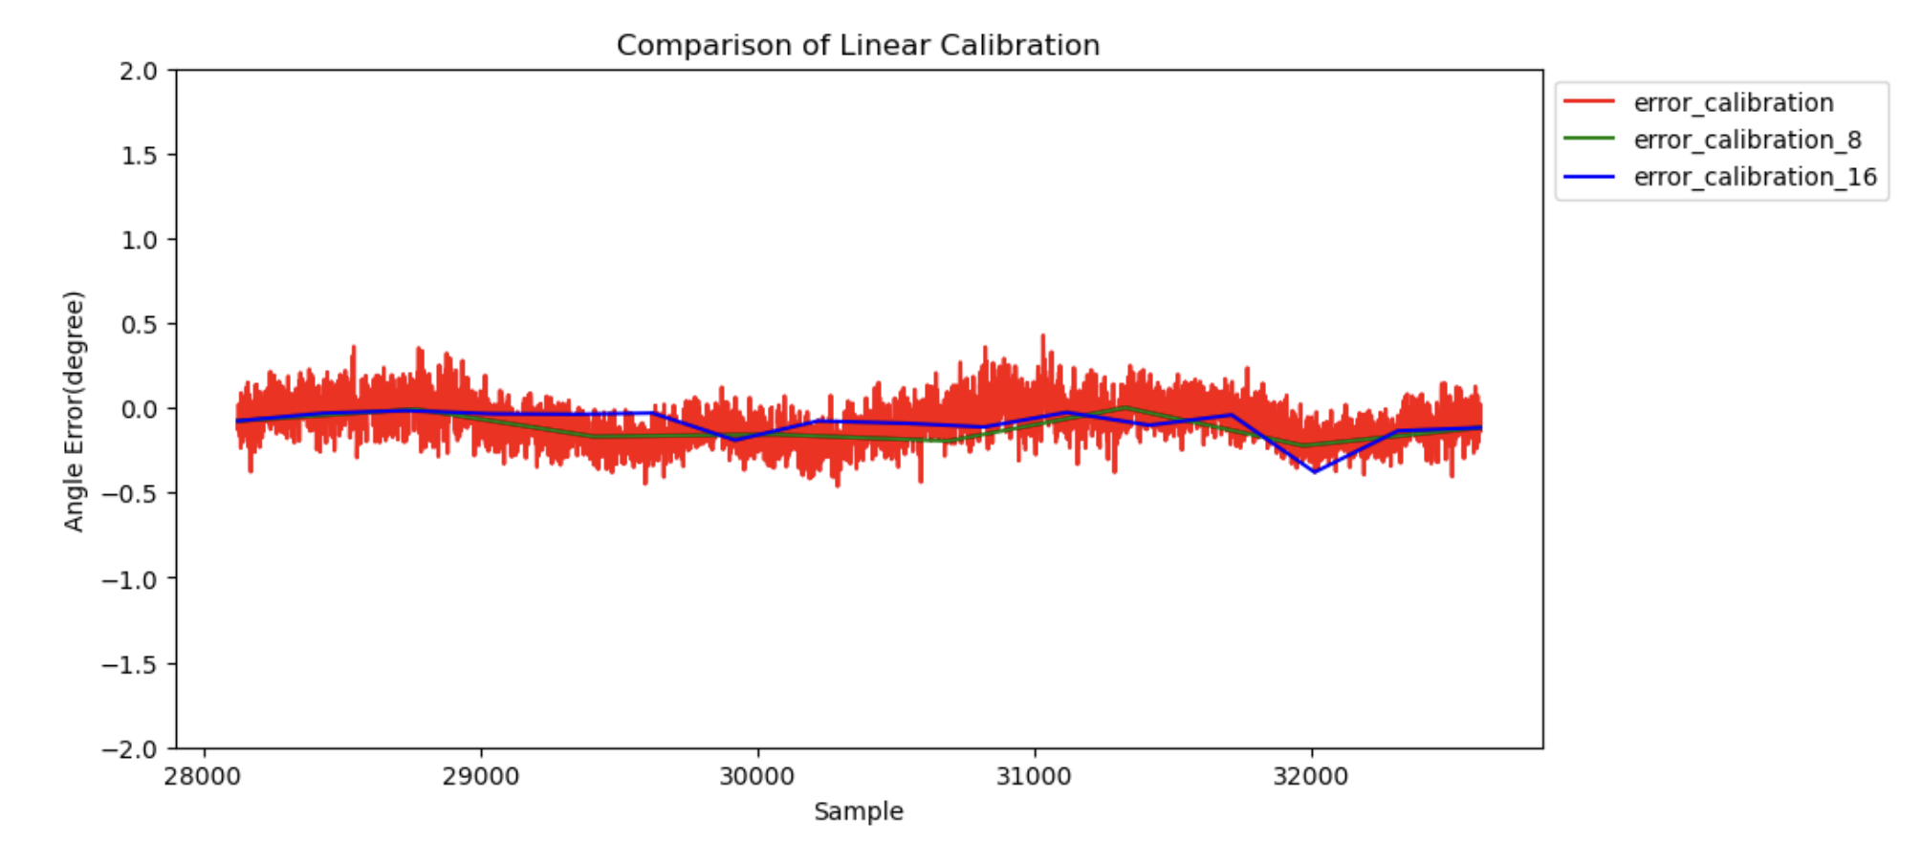
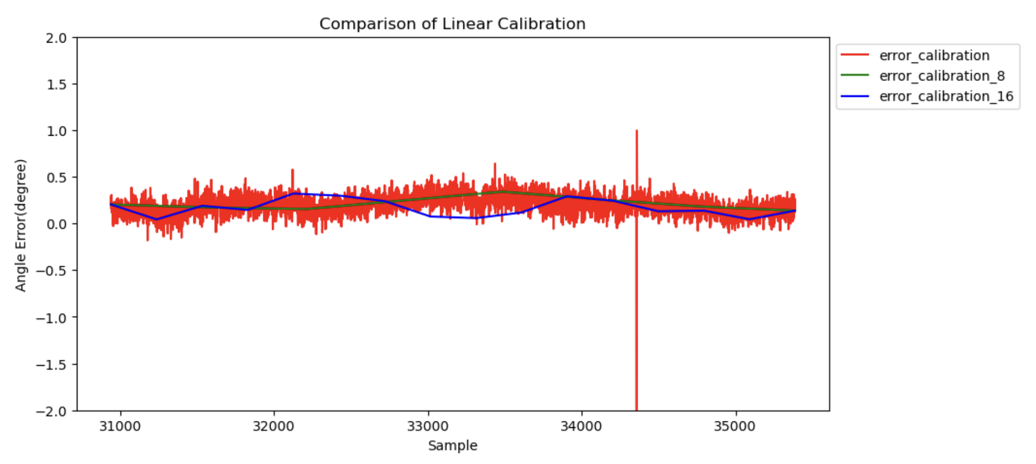
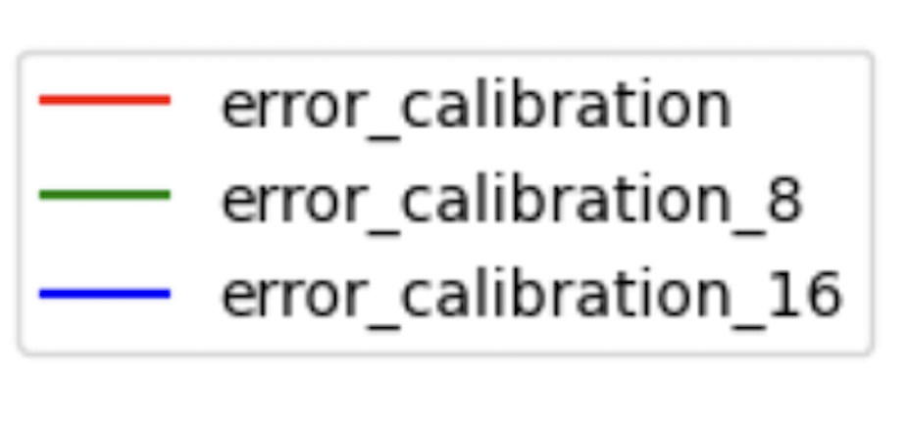
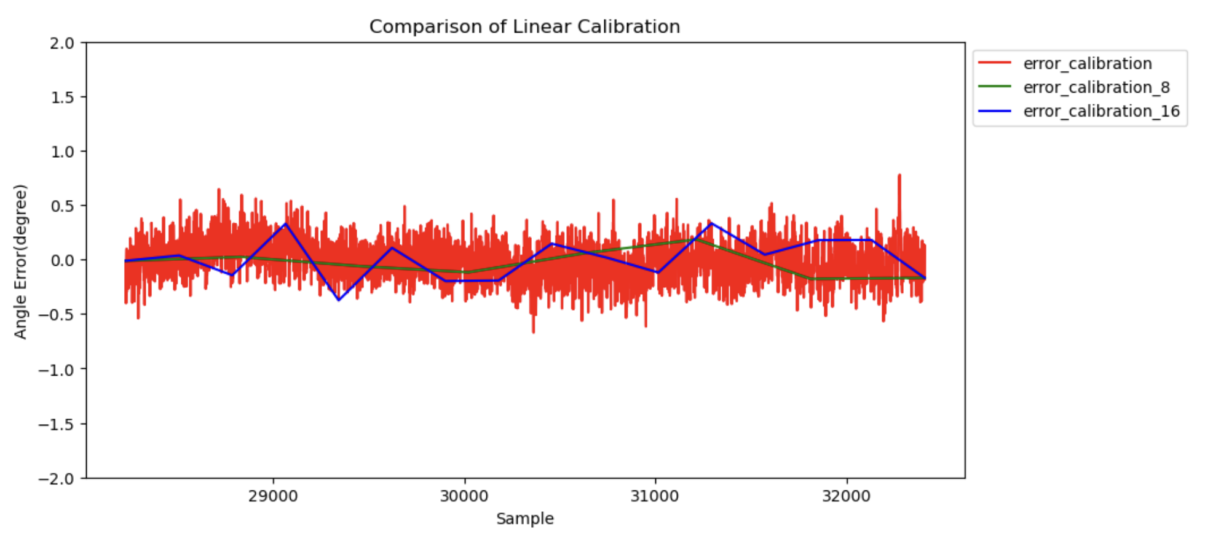
Results
Figure 1: Multi-point Calibration for Dataset x40_y40_z40
Figure 2: Multi-point Calibration for Dataset x40_y40_z70
Figure 3: Multi-point Calibration for Dataset x60_y20_z50

Slide 13
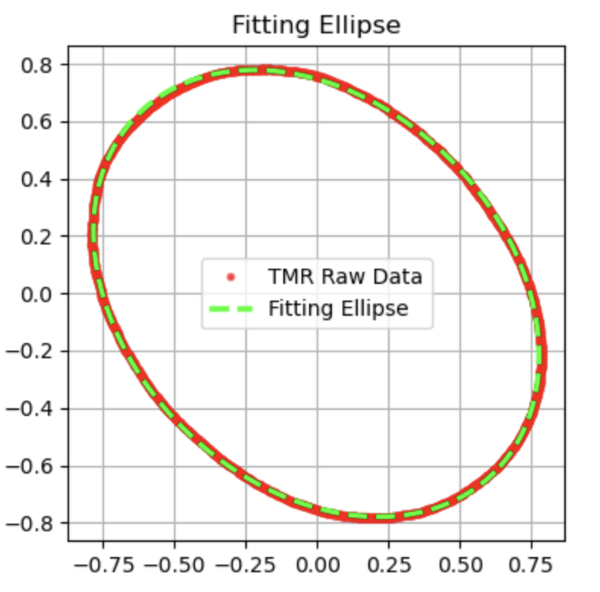
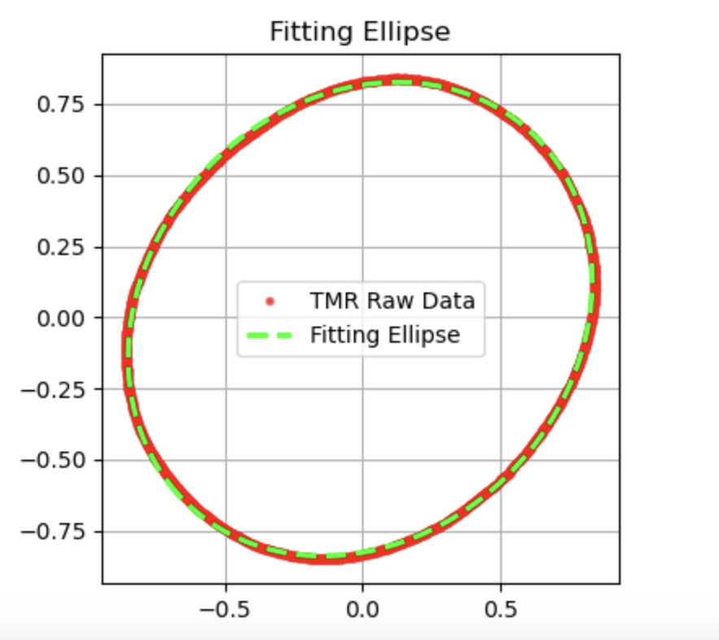
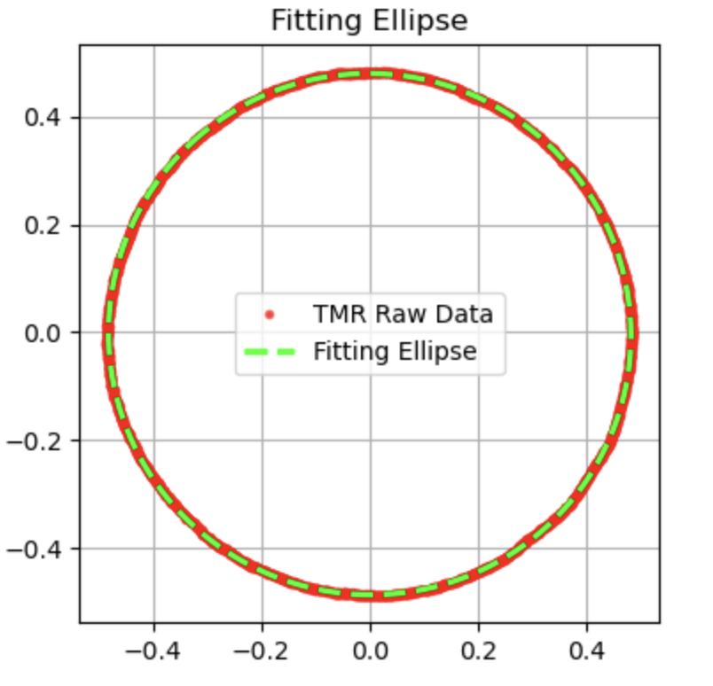
Results
Figure 4: Fitting Ellipse for Dataset x40_y40_z40
Figure 5: Fitting Ellipse for Dataset x40_y40_z70
Figure 6: Fitting Ellipse for Dataset x60_y20_z50

Slide 14
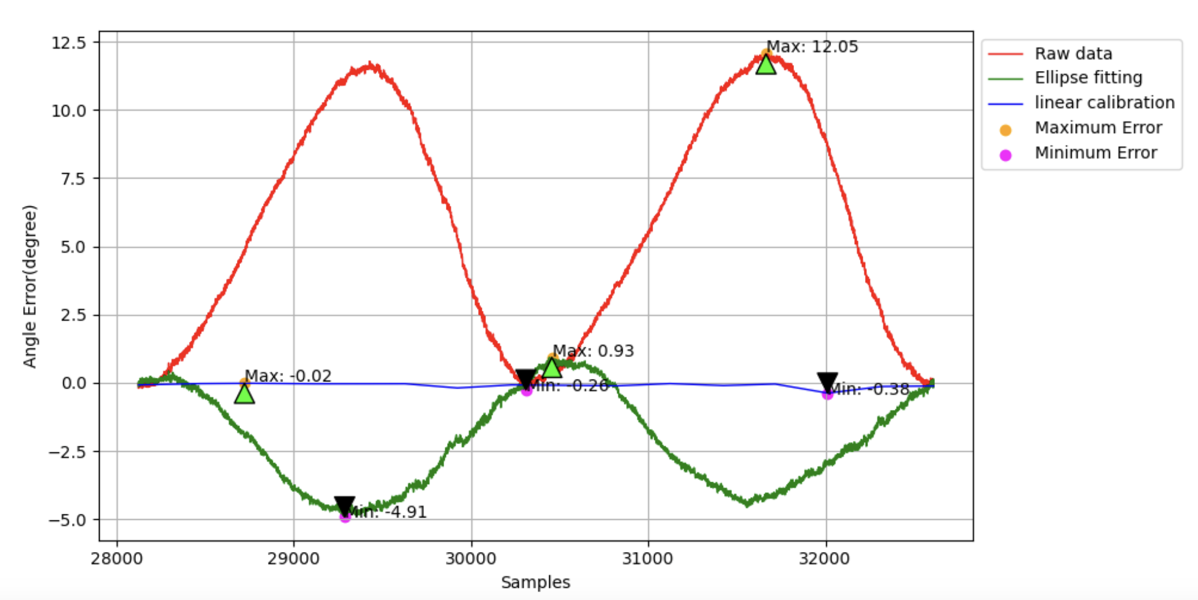
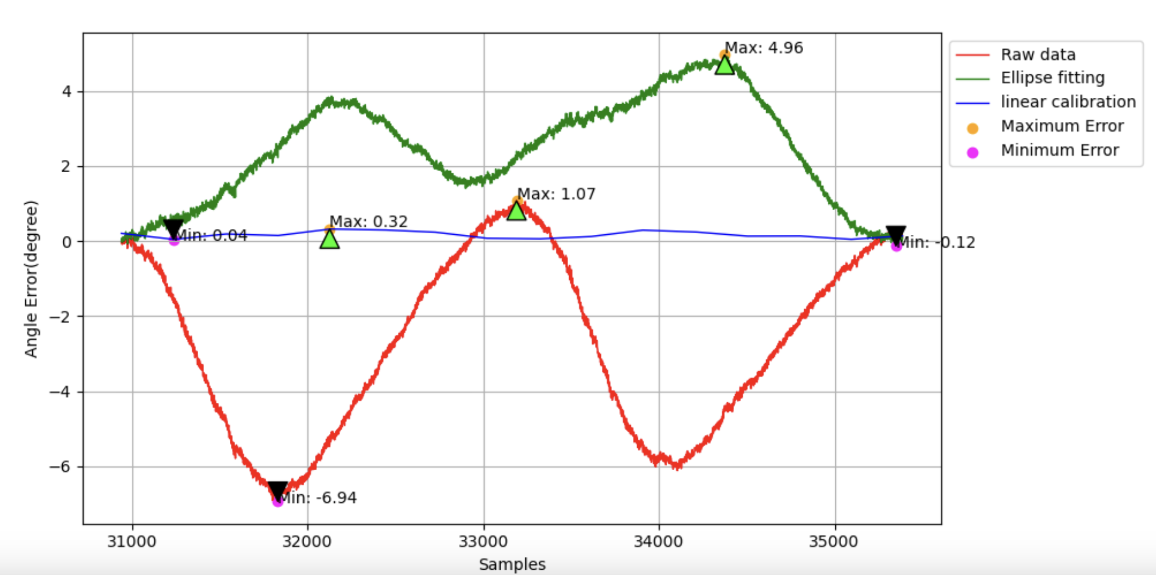
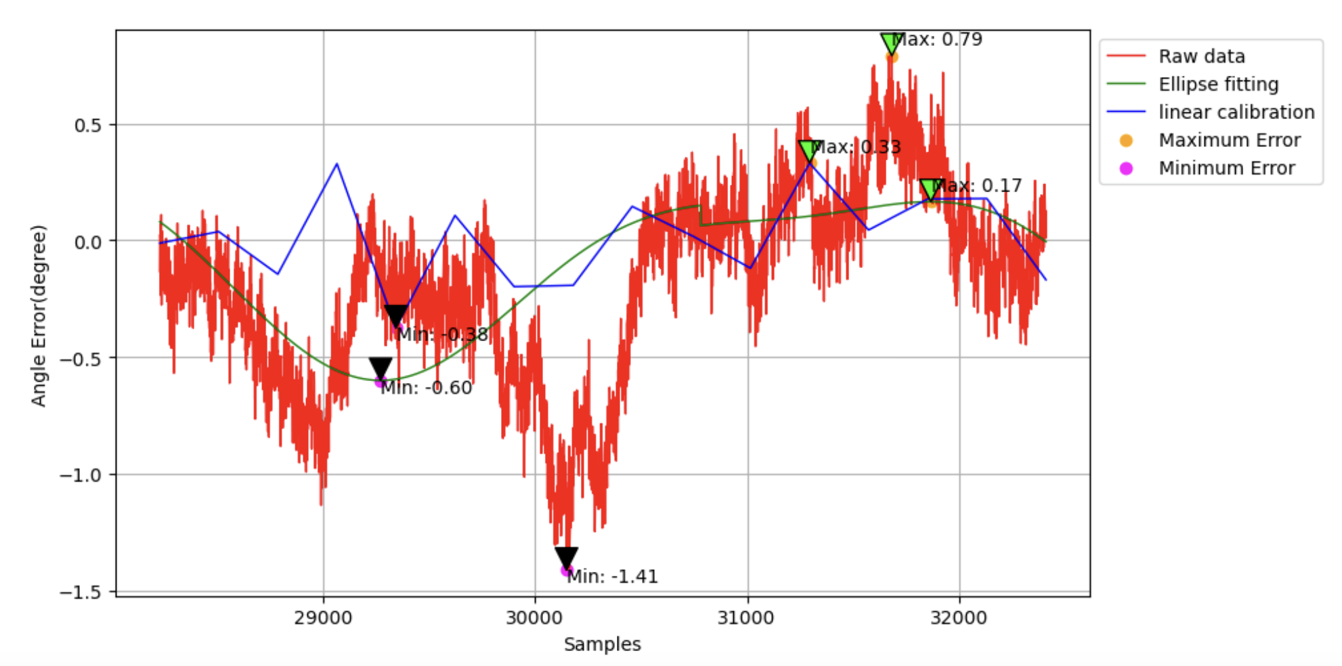
Results
(a)
(b)
Figure 7:
(a) Comparison of Different Calibration Methods for Dataset x40_y40_z40
(b) Comparison of Different Calibration Methods for Dataset x40_y40_z70
(c) Comparison of Different Calibration Methods for Dataset x60_y20_z50
(c)

Slide 15
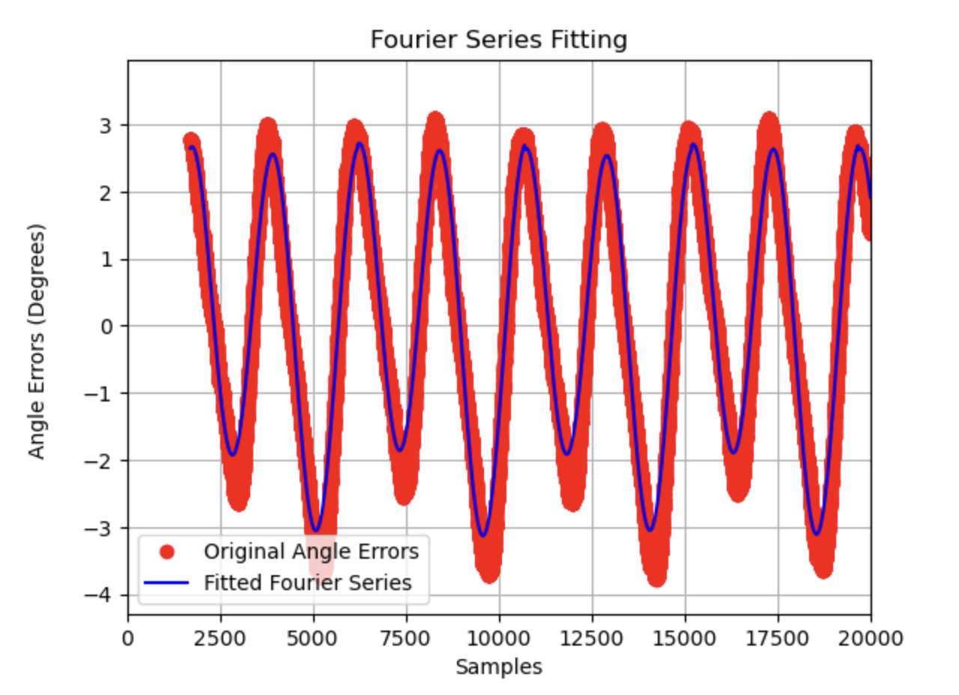
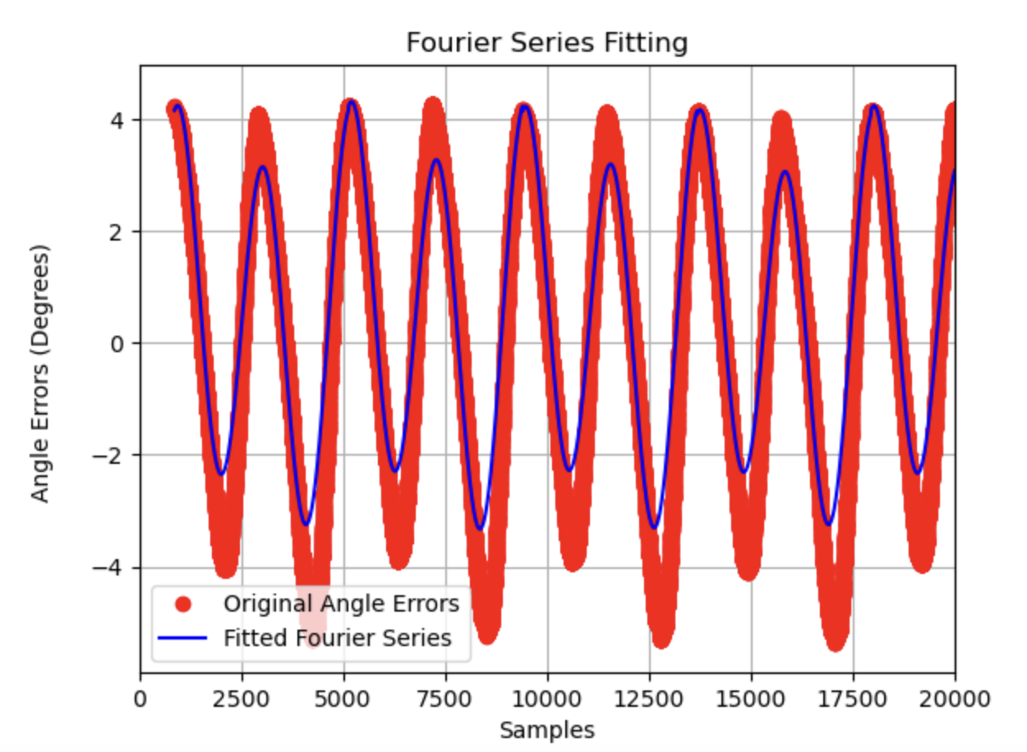
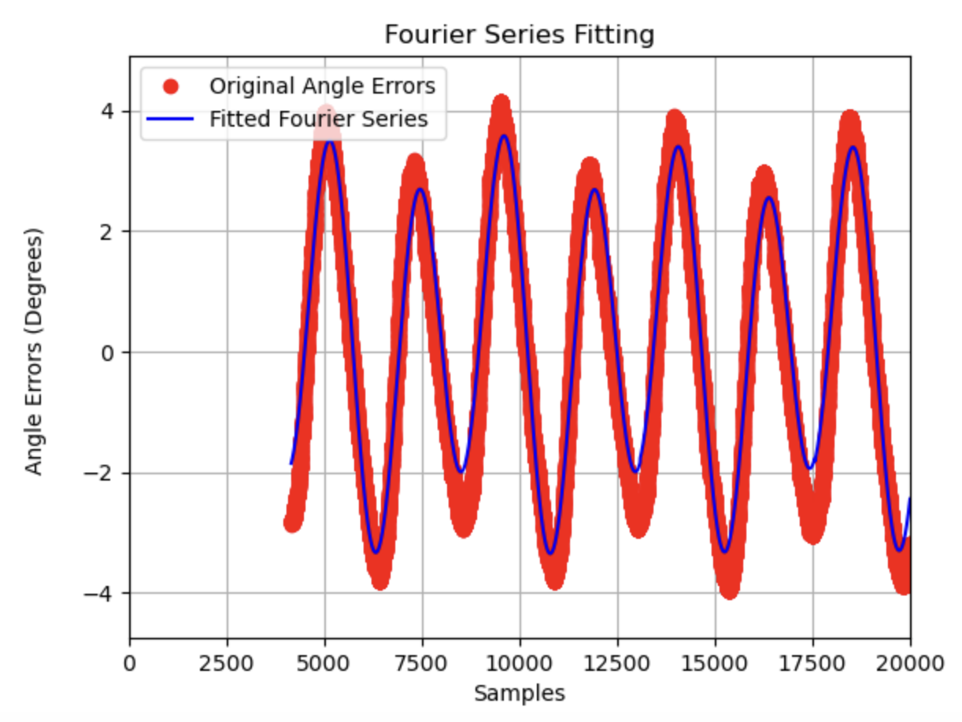
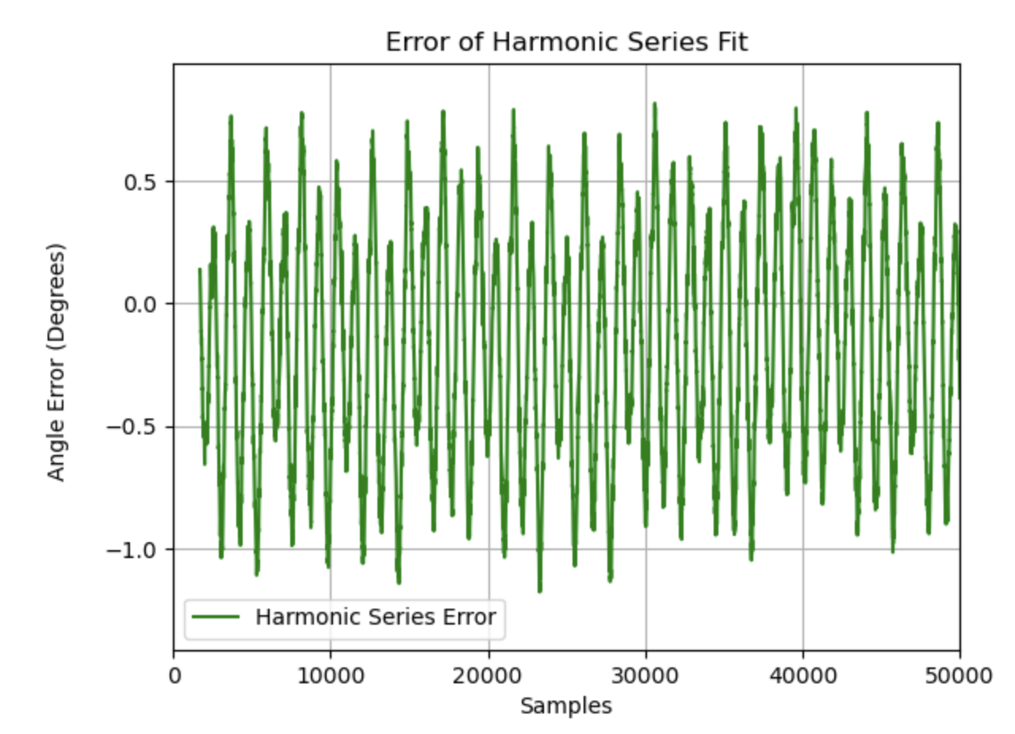
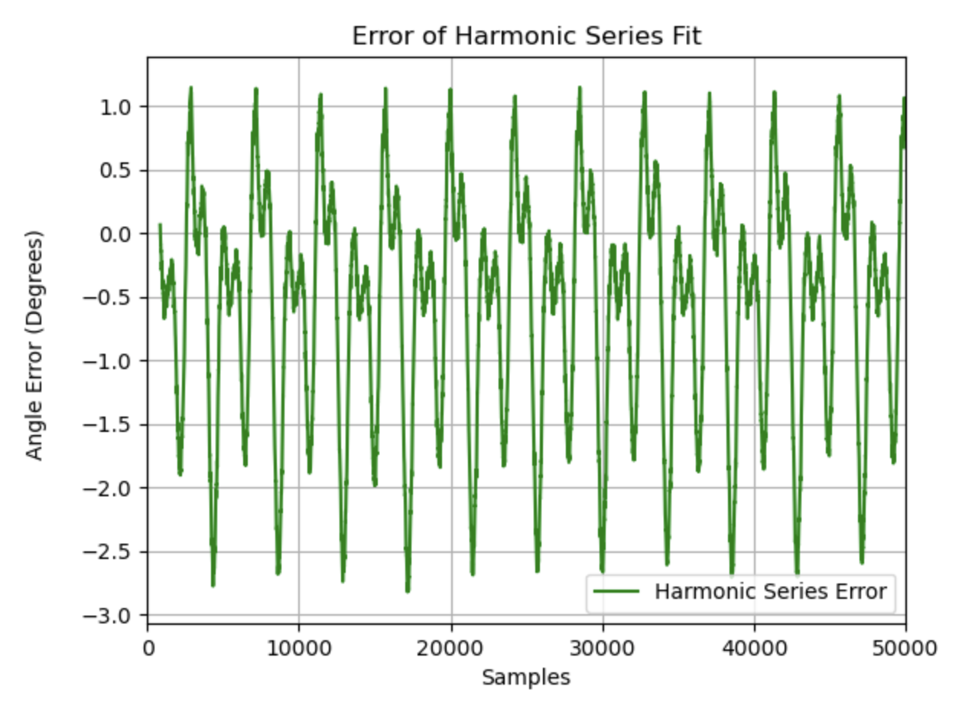
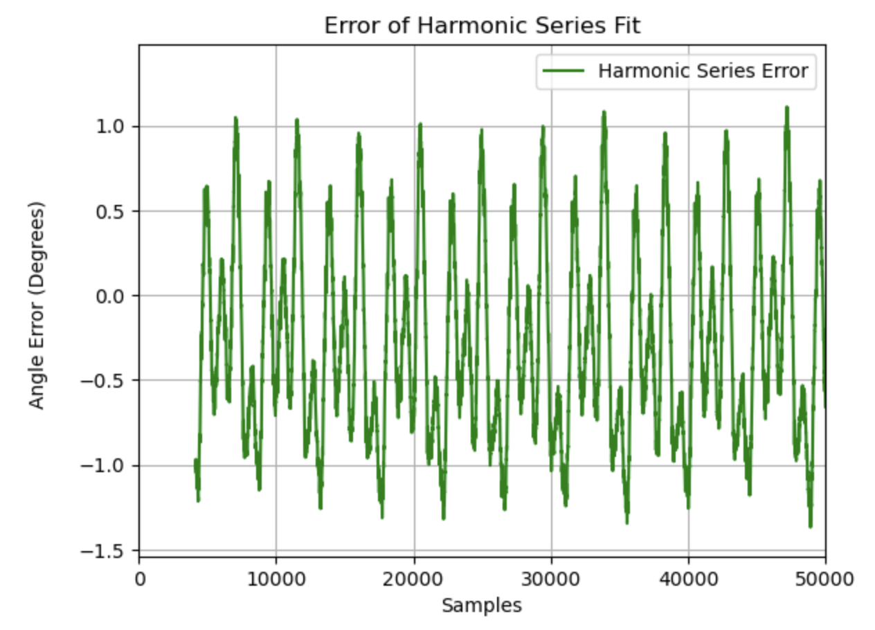
Results
Figure 8: FS Fitting Curve (Top) and FS Fitting Error Curve (Bottom) for Dataset x40_y20_z65
Figure 9: FS Fitting Curve (Top) and FS Fitting Error Curve (Bottom) for Dataset x40_y20_z70
Figure 10: FS Fitting Curve (Top) and FS Fitting Error Curve (Bottom) for Dataset x40_y40_z70

Slide 16
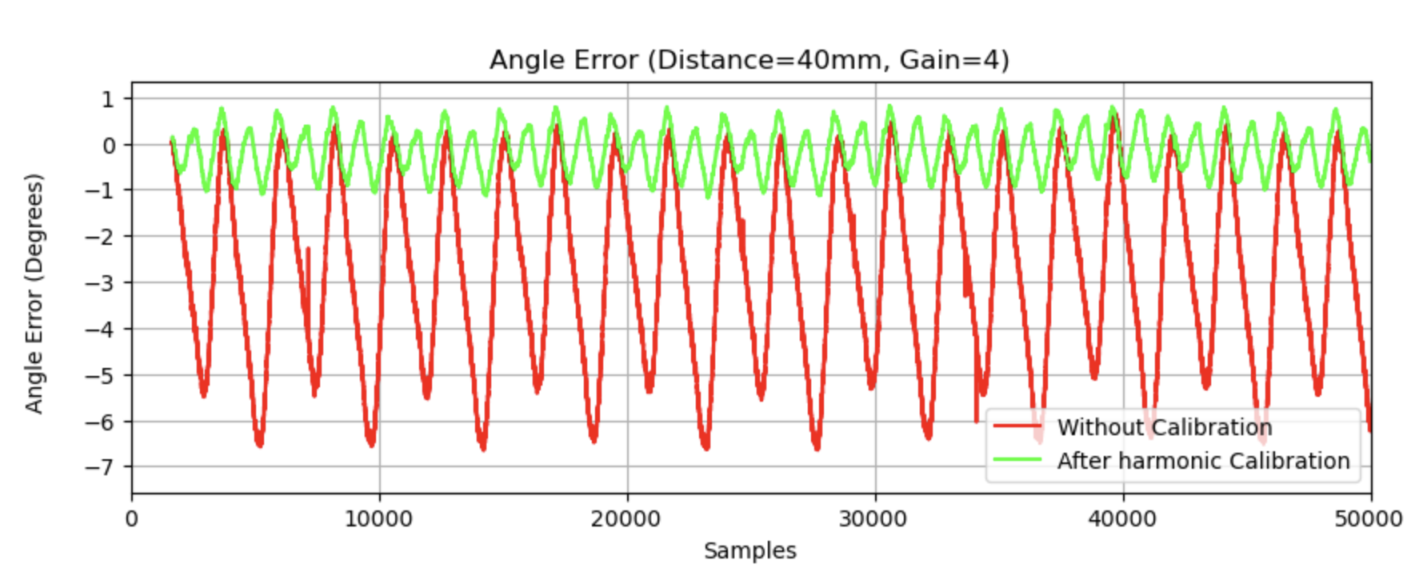
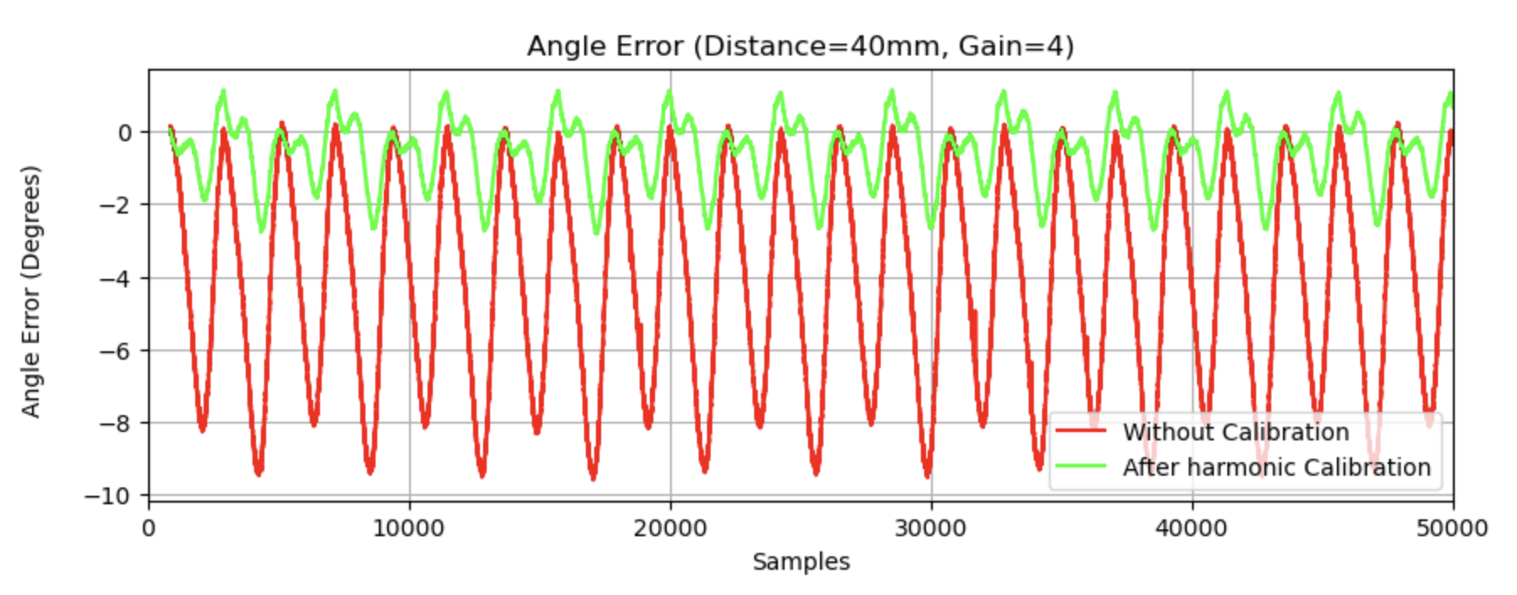
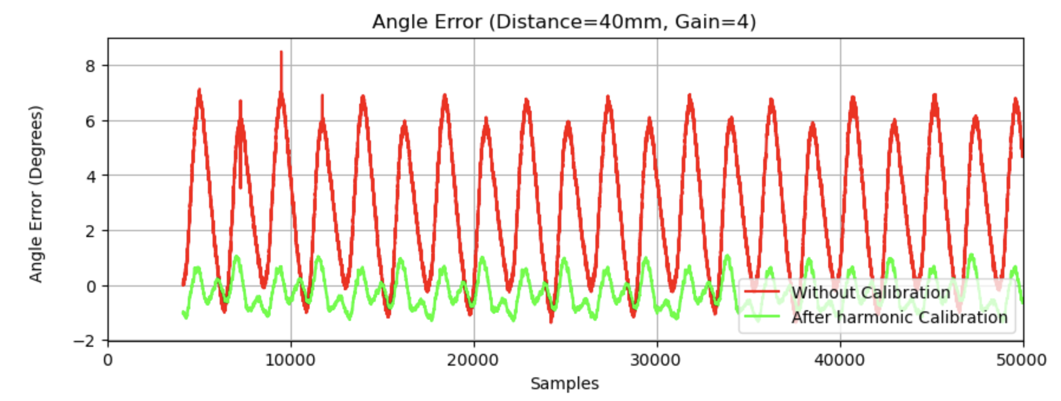
Results
Figure 11:Angle Error Curve with and without Calibration for Dataset x40_y20_z65
Figure 12:Angle Error Curve with and without Calibration for Dataset x40_y20_z70
Figure 13:Angle Error Curve with and without Calibration for Dataset x40_y40_z70

Slide 17
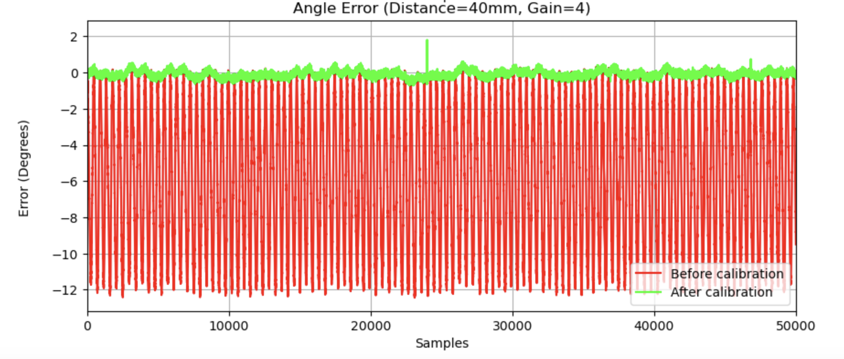
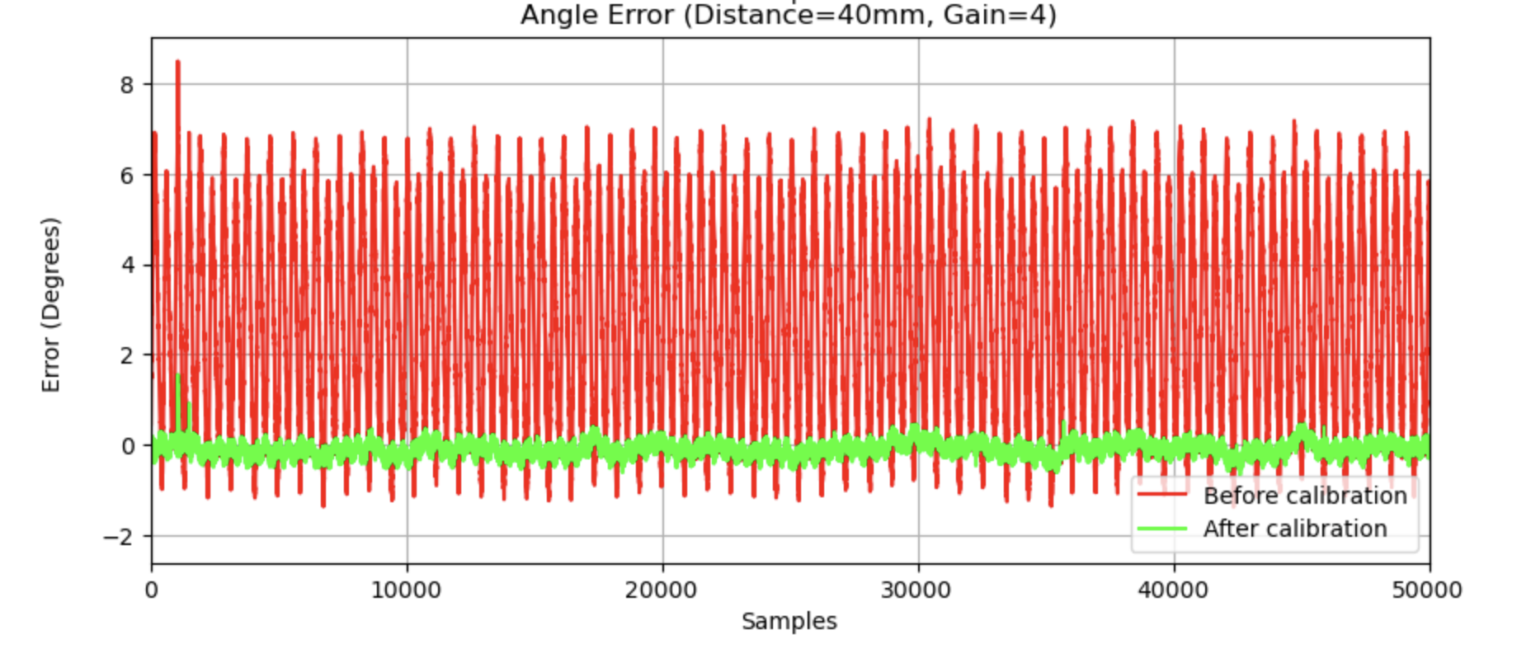
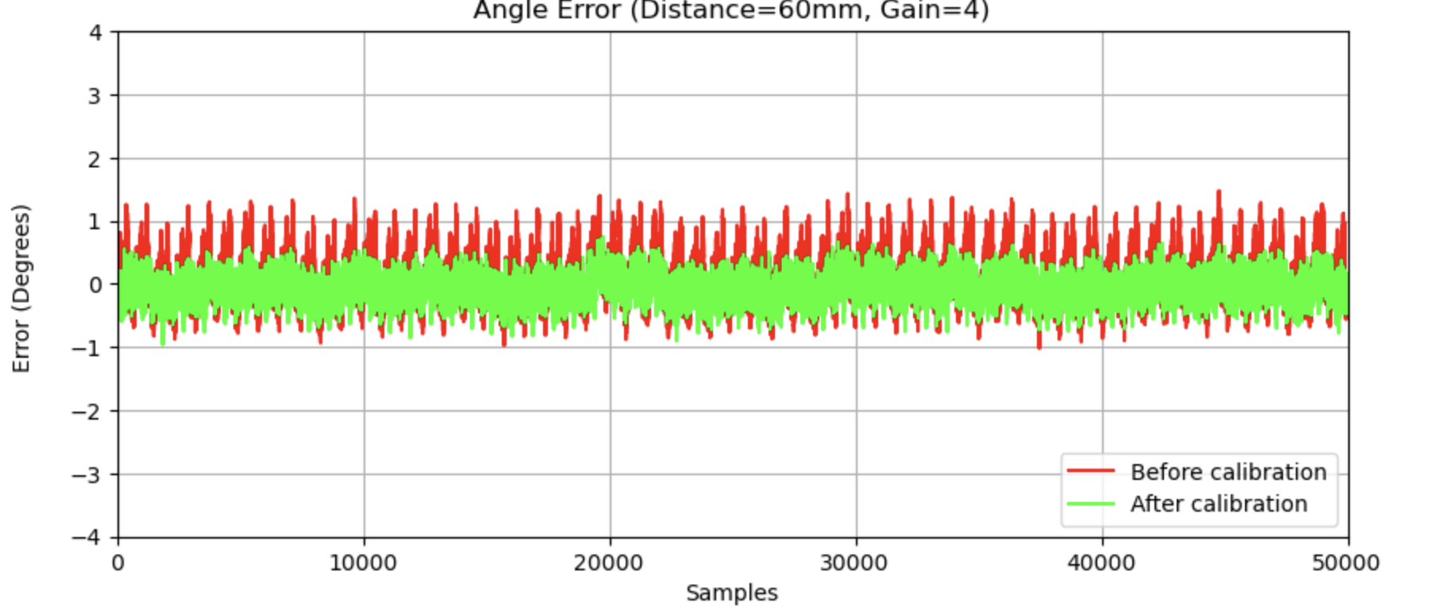
Results
Figure 14: CNN Calibration Result for Dataset x40_y40_z40
Figure 15: CNN Calibration Result for Dataset x40_y40_z70
Figure 16: CNN Calibration Result for Dataset x60_y20_z50

Slide 18
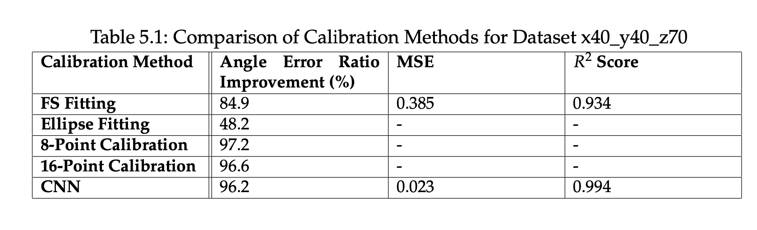
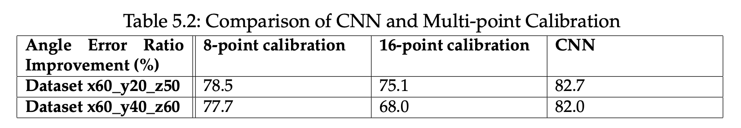
Results
Table 1：Comparison of Calibration Methods for Dataset x40_y40_z70
Table 2：Comparison of CNN and Multi-point Calibration

Slide 19
Conclusion
This work presented four calibration methods for enhancing accuracy of TMR sensor angle measurements: linear calibration, Fourier and ellipse fitting, and CNN-based calibration.
Linear calibration still requires improvement as selecting calibration points with multi-point calibration introduces uncertainties, especially for unprocessed, non-smooth curves, leading to higher error rates.
Fourier curve fitting showed effectiveness on specific datasets, but optimizing initial parameter settings could improve reliability.
Ellipse fitting was particularly successful with Lissajous patterns, though algebraic fitting had limitations in aligning errors and verifying parameter accuracy; exploring geometric models may improve results.
CNN calibration achieved substantial error reduction, and future studies could further refine CNN architecture and training.

Slide 20
Thank you！

Slide 21
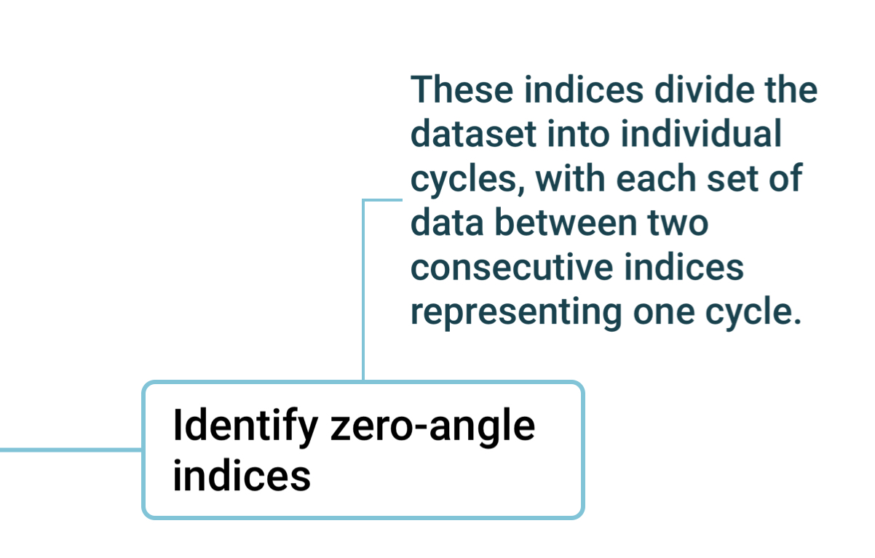
Linear Calibration

Slide 22
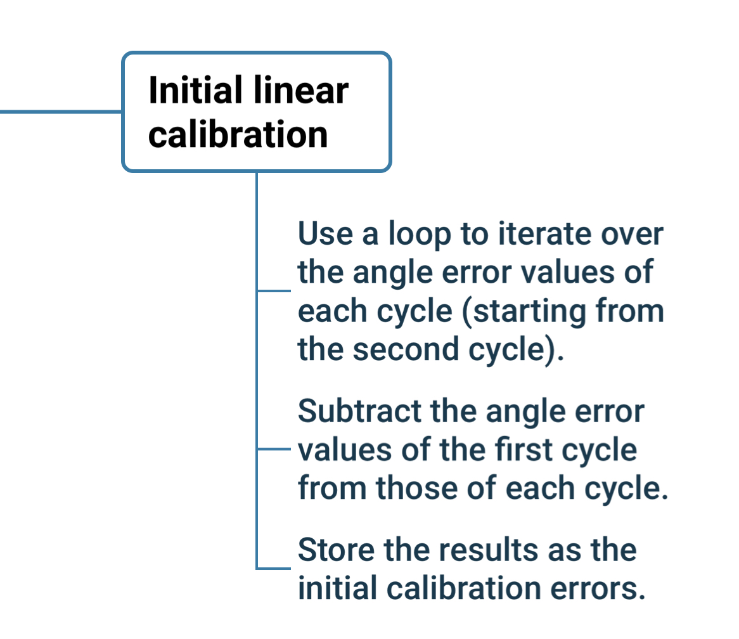
Linear Calibration

Slide 23
Linear Calibration

Slide 24
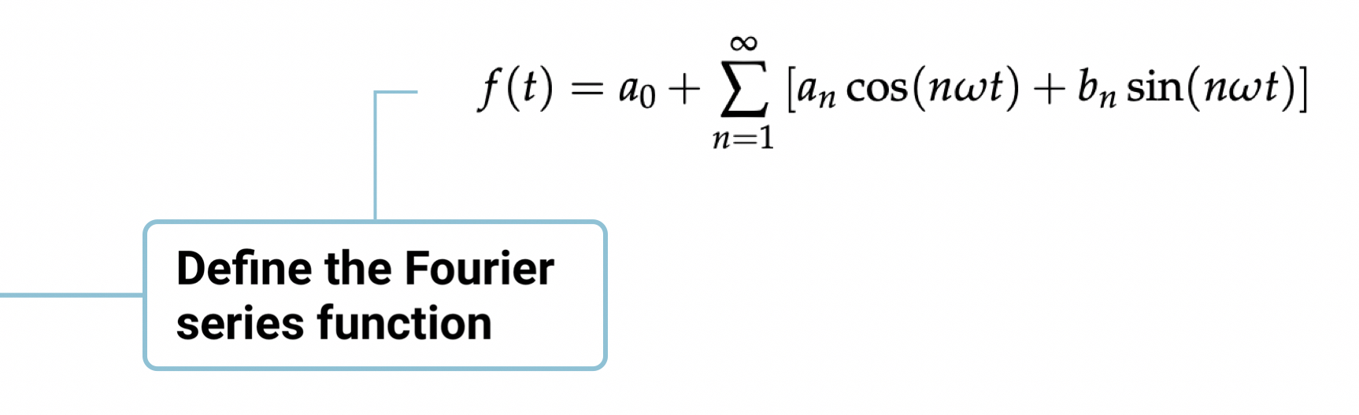
Harmonic Calibration

Slide 25
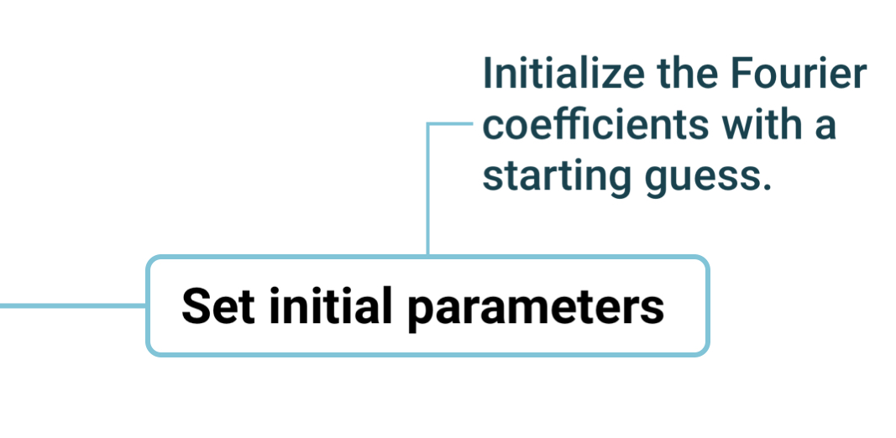
Harmonic Calibration

Slide 26
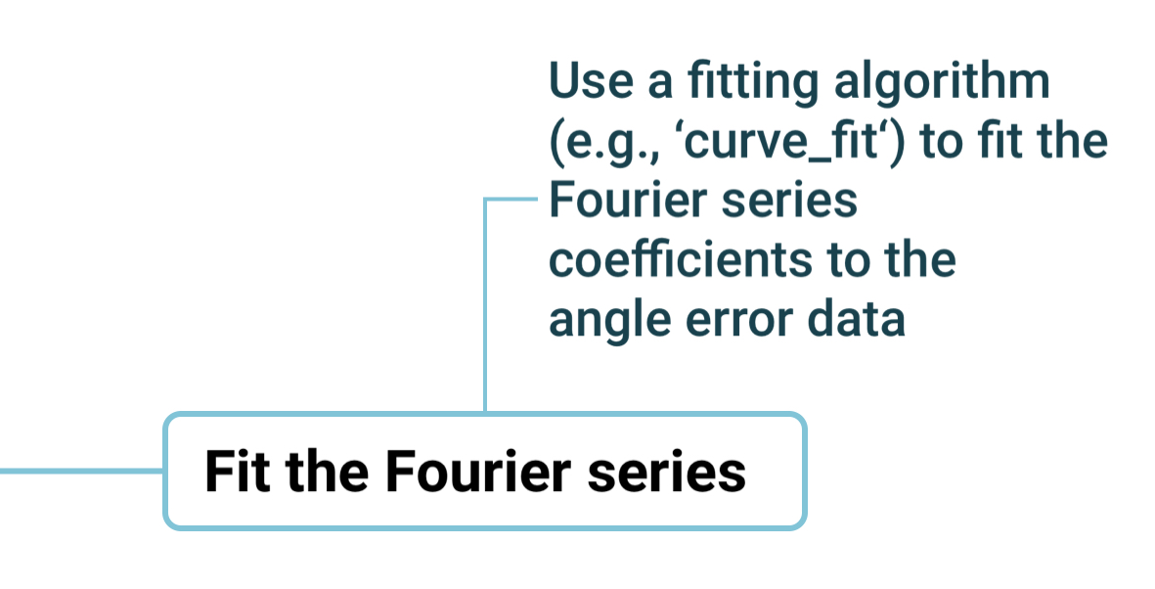
Harmonic Calibration

Slide 27
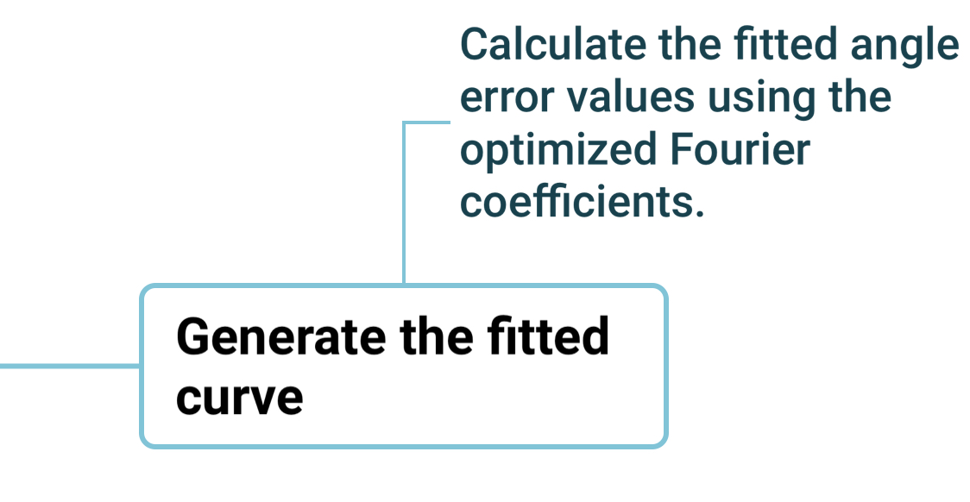
Harmonic Calibration

Slide 28
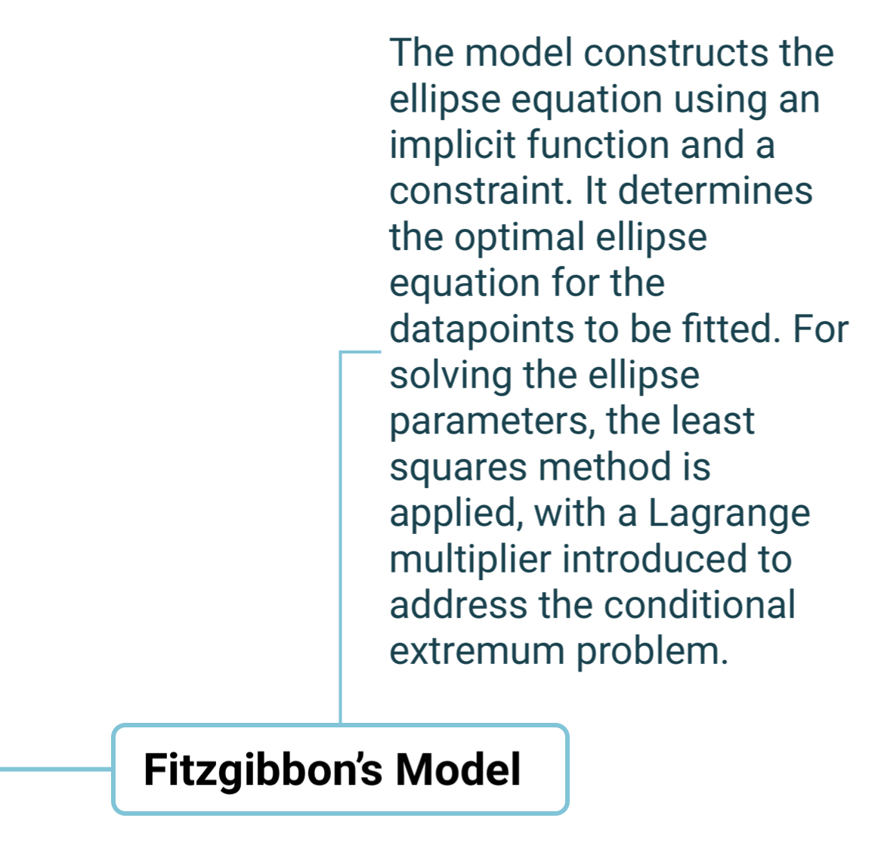
Ellipse Fitting

Slide 29
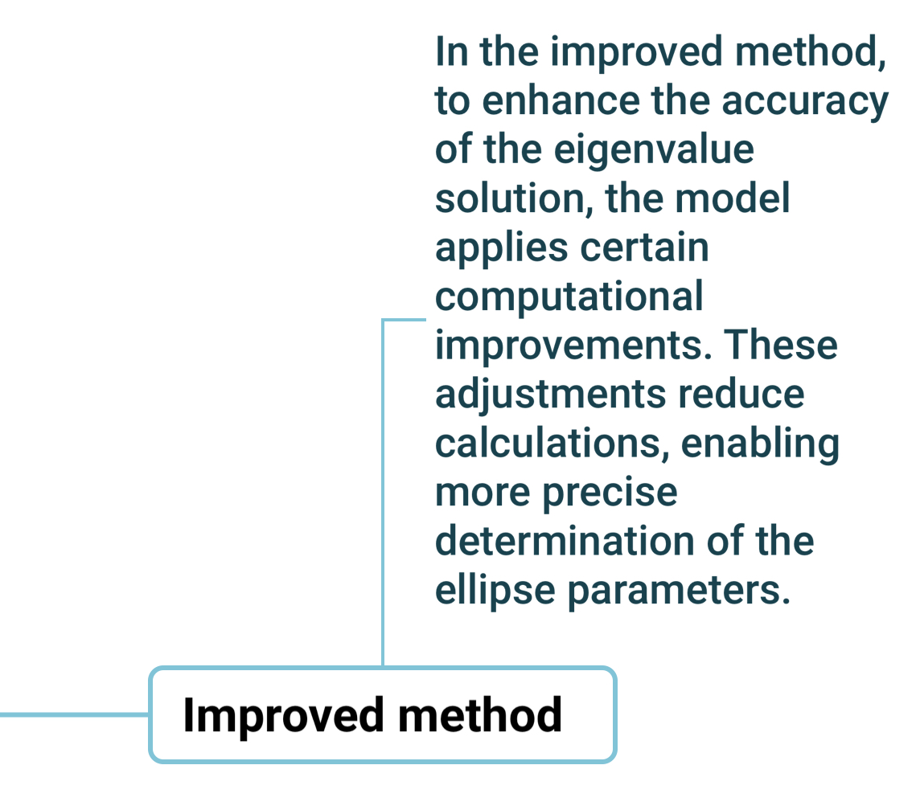
Ellipse Fitting

Slide 30
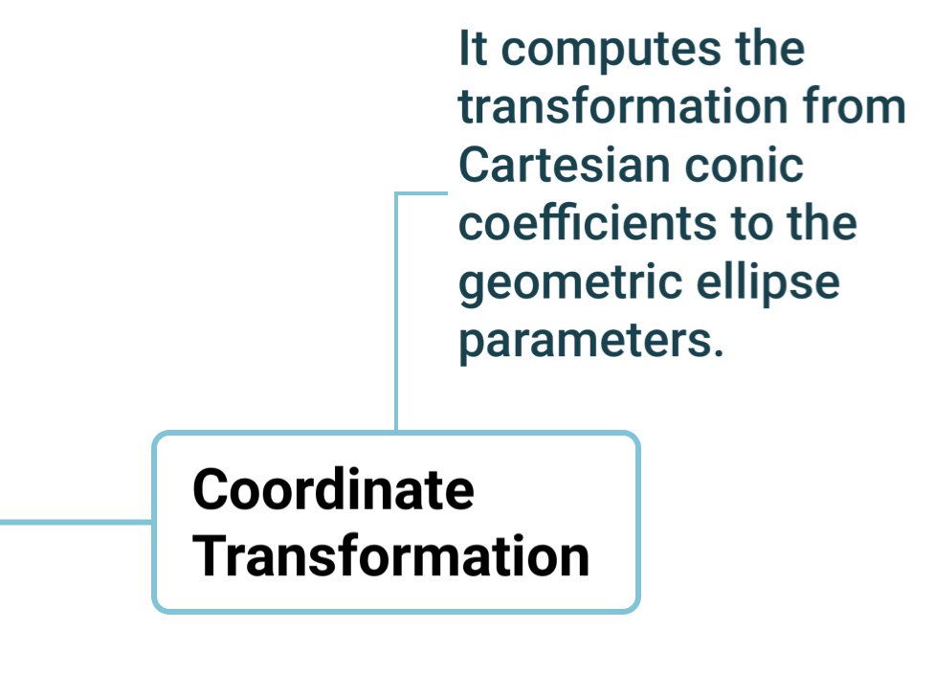
Ellipse Fitting

Slide 31
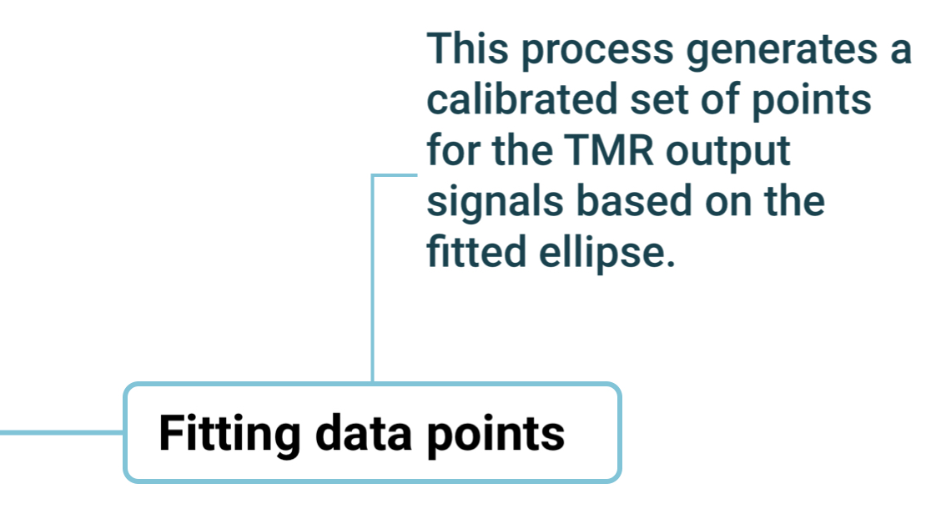
Ellipse Fitting

Slide 32
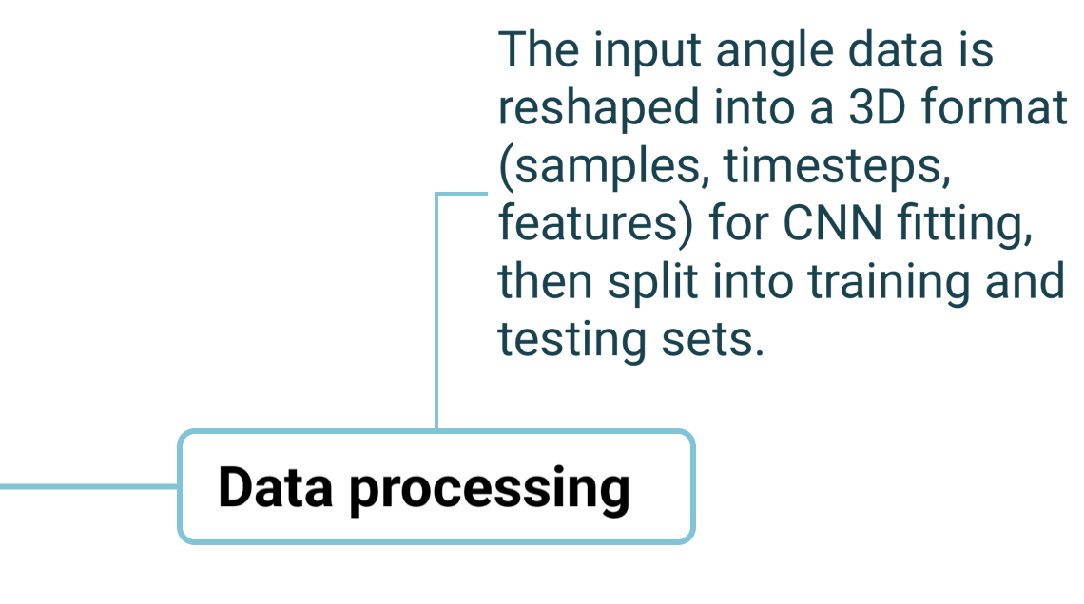
CNN

Slide 33
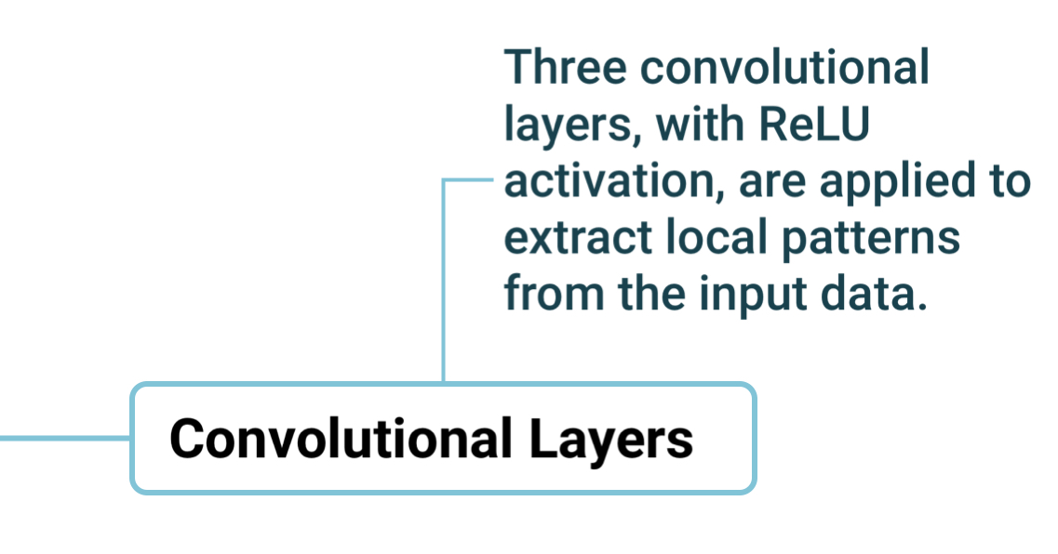
CNN

Slide 34
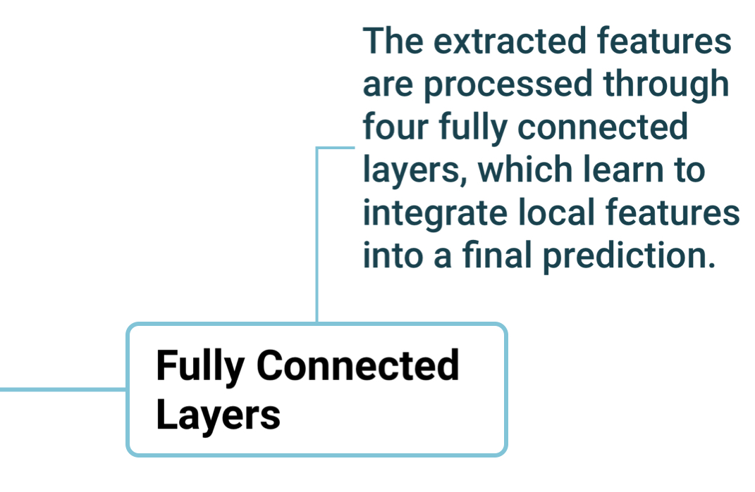
CNN

Slide 35
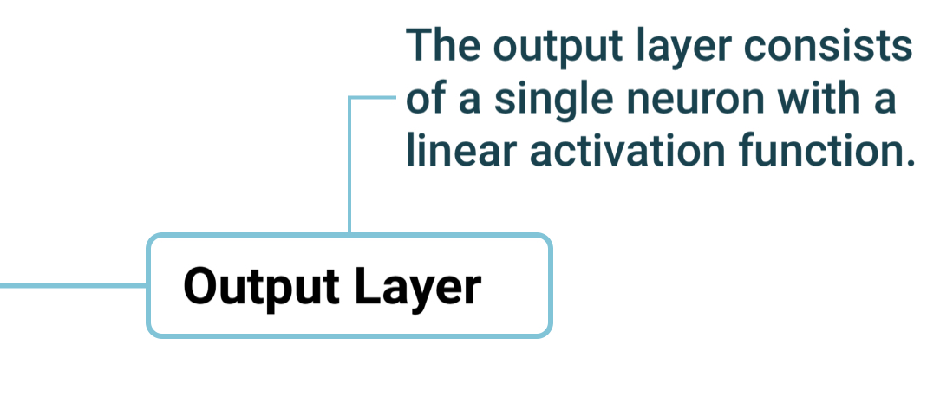
CNN

Slide 36
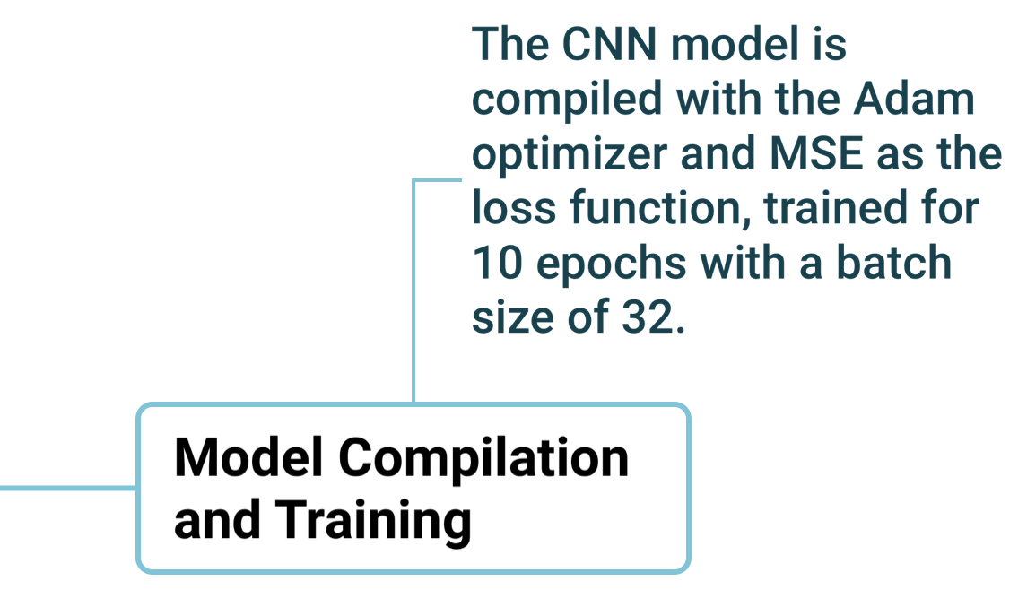
CNN

Slide 37
References
[1] Albrecht Jander, Carl Smith, and Robert Schneider. Magnetoresistive sensors for nondestructive evaluation (invited paper). In Proceedings of SPIE - The Interna- tional Society for Optical Engineering, volume 5770, 2005.
[2] Ioanna Giouroudi and Franz Keplinger. Microfluidic biosensing systems us- ing magnetic nanoparticles. International Journal of Molecular Sciences, 14:18535– 18556, 2013.
[3] TDK Corporation. Principles of tmr element sensing. https://product.tdk. com/en/techlibrary/productoverview/tmr-angle-sensors.html. Accessed: 2024-09-14.
[4] Antoine Hilberer, G. Laurent, A. Lorin, A. Partier, Julien Bobroff, F. Bouquet, Catherine Even, Jean-Marie Fischbach, Claire Akiko Marrache-Kikuchi, Miguel Monteverde, B. Pilett, and Q. Quay. Temperature-dependent transport measure- ments with arduino. Papers in Physics, 10, 2018.
[5] Texas Instruments. Achieving Highest System Angle Sensing Accuracy. https: //www.ti.com.cn/cn/lit/an/sbaa539/sbaa539.pdf. Accessed: 2024-02-15.

Slide 38
References
[6] Elena Gerken, Qummar Zaman, Senan Alraho, and Andreas König. Advanced self-x architecture for improved angle accuracy restoration in tmr-based angular decoders. In Proceedings of the Sensors 2024 Conference, pages 452–459, 2024.
[7] Yamazakietal.B8.4-characteristicsoftmranglesensors.InProceedingsSENSOR 2011, AMA Science, pages 361–365, 2011.
[8] Melexis. Back-end calibration for triaxis position sensors, Novem-
ber 2021. Available online: https://www.mouser.com/pdfDocs/ Back-End-Calibration-Triaxis-Sensors-Application-Note-Melexis.pdf.
[9] N. K. Bhaskarrao, C. S. Anoop, and P. Kumar Dutta. A linearizing interface cir- cuit with phase-error compensated direct-digital output for tmr-based angular position sensor. In 2017 IEEE International Instrumentation and Measurement Tech- nology Conference (I2MTC), pages 1–6, Turin, Italy, 2017. IEEE.
[10] RichardJ.Graetz.On-AxisSelf-CalibrationofAngleMeasurementErrorsinPrecision Rotary Encoders. Electronic theses and dissertations (etds) 2008+, University of British Columbia, 2011. T.

Slide 39
References
[11] K. Rohrmann, P. Meier, M. Sandner, and M. Prochaska. A novel methodology for stray field insensitive xmr angular position sensors. In 2018 IEEE SENSORS, pages 1–4, New Delhi, India, 2018. IEEE.
[12] Y. Hu, Y. Zhan, L. Han, P. Hu, B. Ye, and Y. Yu. An angle error compensation method based on harmonic analysis for integrated joint modules. Sensors (Basel), 20(6):1715, Mar 2020.
[13] Marcus Pinto, Noara Foiatto, and Marcos Stemmer. Calibration system devel- oped to the harmonic measurements with dft techniques. 2013.
[14] Z. Yu and Z. Hao. Calibration of the angle measurement error caused by the industrial reducer performance test instrument torsional deformation. Scientific Reports, 12:21742, 2022.
[15] M. Baum and U.D. Hanebeck. Fitting conics to noisy data using stochastic lin- earization. In 2011 IEEE/RSJ International Conference on Intelligent Robots and Sys- tems (IROS), pages 2050–2055, 2011.

Slide 40
References
[16] Radim Hal oy and Jan Flusser. Numerically stable direct least squares fitting of ellipses. 1998.
[17] W. Gander, G.H. Golub, and R. Strebel. Least-squares fitting of circles and el- lipses. BIT Numerical Mathematics, 34:558–578, 1994.
[18] Sung Joon Ahn and Wolfgang Rauh. Geometric least squares fitting of circle and ellipse. International Journal of Pattern Recognition and Artificial Intelligence (IJPRAI), 13:987–996, 1999.
[19] S.J. Ahn, W. Rauh, and M. Recknagel. Ellipse fitting and parameter assessment of circular object targets for robot vision. In Proceedings of the 1999 IEEE/RSJ International Conference on Intelligent Robots and Systems (IROS), volume 1, pages 525–530, 1999.
[20] Tomaž Požar and Janez Možina. Enhanced ellipse fitting in a two-detector ho- modyne quadrature laser interferometer. Measurement Science and Technology, 2011.

Slide 41
References
[21] P. Meier, K. Rohrmann, M. Sandner, M. Streitenberger, and M. Prochaska. Con- volutional neural networks for robust angular measurement with xmr sensor arrays. In 2019 IEEE International Instrumentation and Measurement Technology Conference (I2MTC), pages 1–6. IEEE, 2019.
[22] A. Sachenko, A. Komarov, and V. Dubrovin. Sensor errors prediction using neu- ral networks. In Proceedings of the IEEE-INNS-ENNS International Joint Conference on Neural Networks (IJCNN 2000), volume 4, pages 441–446, Como, Italy, 2000. IEEE.
[23] L. Wang, J. Liu, Y. Yan, X. Wang, and T. Wang. Gas-liquid two-phase flow mea- surement using coriolis flowmeters incorporating neural networks. In 2016 IEEE International Conference on Industrial Technology (ICIT), pages 1234–1239, Taipei, Taiwan, 2016. IEEE.
[24] Michael Werman and Daniel Keren. A bayesian method for fitting parametric and nonparametric models to noisy data. IEEE Transactions on Pattern Analysis and Machine Intelligence, 23(5):528–534, 2001.

Slide 42
References
[25] Isaschar Genish, Yevgeny Kats, Lior Klein, J. Reiner, and M. Beasley. Param- agnetic anisotropic magnetoresistance in thin films of srruo3. Journal of Applied Physics, 95, 2003.
[26] Giuseppe Giuliani. A general law for electromagnetic induction. EPL (Euro- physics Letters), 81:60002, 2008.
[27] E. H. Hall. On a new action of the magnet on electric currents. American Journal of Mathematics, 2(3):287–292, 1879.
[28] M. Meyer. Chances of xmr-sensors in automotive applications. In Proceedings of the 11th Symposium Magnetoresistive Sensors and Magnetic Systems, Wetzlar, Ger- many, pages 29–30, March 2011.
[29] Texas Instruments. Tmag6181-q1 high-precision analog amr angle sensor with integrated turns counter. https://www.ti.com/product/TMAG6181-Q1. Ac- cessed: 2024-09-14.

Slide 43
References
[30] Murata Manufacturing Co., Ltd. Amr sensor applications. https://www. murata.com/en-us/products/sensor/amr/overview/apps/omni-directional. Accessed: 2024-09-14.
[31] C. Chappert, A. Fert, and F. Van Dau. The emergence of spin electronics in data storage. Nature Materials, 6:813–823, 2007.
[32] Mario Baibich, Jean-Marc Broto, A. F. Fert, Frederic Nguyen-Van-Dau, Frederic Petroff, P. E. Etienne, G. Creuzet, A. Friederich, and J. Chazelas. Giant mag- netoresistance of (001)fe/(001)cr magnetic superlattices. Physical Review Letters, 61:2472–2475, 1988.
[33] G. Binasch, P. Grünberg, F. Saurenbach, and W. Zinn. Enhanced magnetoresis- tance in layered magnetic structures with antiferromagnetic interlayer exchange. Physical Review B: Condensed Matter, 39(7):4828–4830, 1989.
[34] S. Parkin, C. Kaiser, A. Panchula, et al. Giant tunnelling magnetoresistance at room temperature with mgo (100) tunnel barriers. Nature Materials, 3:862–867, 2004.

Slide 44
References
[35] E. Gerken, Q. Zaman, S. Alraho, and A. König. Development of a self-x sensory electronics for anomaly detection and its conceptual implementation on an xmr- based angular decoder prototype: Entwicklung einer selbst-x-sensorelektronik zur erkennung von anomalien und ihre konzeptionelle umsetzung auf einem xmr-basierten winkeldecoder-prototyp. tm - Technisches Messen, 90(s1):20–26, 2023.
[36] Corporate Finance Institute. Empirical rule. https: //corporatefinanceinstitute.com/resources/data-science/ empirical-rule/, n.d. Accessed: 2024-9-22.
[37] Corporate Finance Institute. Chebyshev’s inequality.
//corporatefinanceinstitute.com/resources/data-science/ chebyshevs-inequality/, n.d. Accessed:2024-9-22.
https:
[38] IBM. What is the k-nearest neighbors (knn) algorithm? https://www.ibm.com/ topics/knn. Accessed: 2024-09-01.

Slide 45
References
[39] Poorna Chandu Sriramoji. Performance of knn values based on k values. https://medium.com/@chandu58627/ performance-of-knn-values-based-on-k-values-f7d95d467b32, 2024. Ac- cessed: 2024-09-01.
[40] GeeksforGeeks. Implementation of polynomial regression. https://www. geeksforgeeks.org/python-implementation-of-polynomial-regression/, n.d. Accessed: 2024-09-01.
[41] Juergen Wittmann and Cihan Belen. Automotive tmr angle sensor performance evaluation, 12 2019.
[42] D.W. Marquardt. An algorithm for least-squares estimation of nonlinear param- eters. Journal of the Society for Industrial and Applied Mathematics, 11(2):431–441, 1963.
[43] Andrew W Fitzgibbon, Maurizio Pilu, and Robert B Fisher. Direct least squares fitting of ellipses. In Proceedings of the 13th International Conference on Pattern Recognition, pages 253–257. IEEE, September 1996.

Slide 46
References
[44] Wolfram Research. Ellipse. https://mathworld.wolfram.com/Ellipse.html. Accessed: 2024-09-11.
[45] Scipyhon. Direct linear least squares fitting of an ellipse. https://scipython. com/blog/direct-linear-least-squares-fitting-of-an-ellipse/, 2021. Ac- cessed: 2024-05-30.
[46] Lamyaa Sadouk. Cnn approaches for time series classification. In Chun-Kit Ngan, editor, Time Series Analysis, chapter 4. IntechOpen, Rijeka, 2018.

